Slide 1
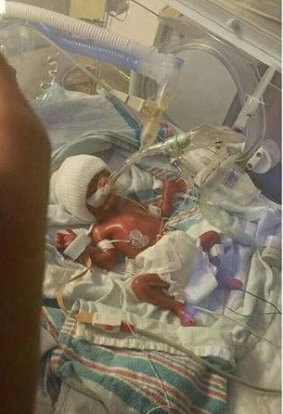
Nutrition in the NICU: Human Milk Diet Provides Better Tolerance, Growth & Cost Effectiveness
A webinar for HealthTrust Members
November 5, 2018
Melinda Elliott, M.D.
Senior Director, Clinical Education & Professional Development,
Prolacta Bioscience
Neonatologist, Pediatrix Medical Group of Maryland

Slide 2
Disclosures
I have had no disclosures until August 1, 2016 when I became a Prolacta Employee. I had no support from Prolacta Bioscience, financial or otherwise, at the time of my studies.
This program may contain the mention of drugs or brands presented in a case study or comparative format using evidence-based research. Such examples are intended for educational and informational purposes and should not be perceived as an endorsement of any particular supplier, brand or drug.
Notes:
I believe in the human milk diet so much, that I now work for Human Milk Based.

Slide 3
Learning Objectives
Describe the American Academy of Pediatrics (AAP) and World Health Organization (WHO) recommendations for the use of human milk in preterm infants
Recall the published benefits of an Exclusive Human Milk Diet (EHMD) in premature infants
Define some long-term outcomes of the EHMD in premature infants

Slide 4
Breast Milk is for Babies, Cows Milk is for Cows*
*We need to stop using our “bovine brains!”

Slide 5
Recommendations on the Use of Human Milk in Premature Infants
All preterm infants should receive human milk
Human milk should be fortified for infants weighing <1500 g at birth
The preferred nutrition for the newborn is his/her own mother’s milk (MOM). When this is not available or is limited, pasteurized human donor breast milk (PDHM) is recommended.
PDHM should be prioritized to compromised preterm infants and selected ill term newborns
“The use of donor human milk in appropriate high-risk infants should not be limited by an individual’s ability to pay. Policies are needed to provide high-risk infants access to donor human milk on the basis of documented medical necessity, not financial status.”
Source: AAP Policy Statement. Pediatrics. 2012;129(3):e827-e841.Pediatrics.2017;139(1):e20163440
Canadian Paediatric Society Position Statement: http://www.cps.ca/en/documents/position/human-milk-banking
WHO Guidelines: http://www.who.int/maternal_child_adolescent/documents/infant_feeding_low_bw/en/

Slide 6
Why Is Human Milk Critical for Premature Newborns?
Infants with GA ≤28 weeks or BW ≤1500 grams have very immature GI tracts
Neonatal GI tract must be colonized with “normal” bacteria after birth
Evidence of abnormal bowel colonization ~1 week prior to development of NEC. (Mai PLOS One 2011)
34% increase of Proteobacteria and
32% decrease in Firmicutes in NEC cases compared to controls
BW = birthweight; GA = gestational age; NEC = necrotizing enterocolitis
Notes:
In the year 2012, there were 56,252 very low birth weight premature infants in the United States (1)

Slide 7
Human Milk and the Preterm Infant Microbiome
Background:
Establishment of infant microbiome known to be influenced by:
Mode of Birth (Vaginal vs. C-Section)
Antibiotic Administration
Environment of Care
Nutritional Exposures (especially Breastfeeding)
Preterm Infants also influenced by Gestational Age at Birth and Postnatal Age at time of testing
Breastfed full-term infants have “better” bacteria and improved Immune Systems
Preterm Infants commonly have Intestinal Dysbiosis, problematic for short- & long-term health, thought to increase risk of NEC

Slide 8
Influence of Maternal Breast Milk Ingestion on Acquisition of the Intestinal Microbiome in Preterm Infants
Observational Study, 30 Infants, <32 weeks, 199 samples, 1st 60 Days
3 Groups: MOM, PDHM (switched to IF at 140 ml/kg/day and >1000g), IF
MOM: More diverse microbiome early in life
Gradual trajectory toward greater diversity over time
IF: Less diverse
Rapid increase in microbial load over time
May lead to overwhelming inflammatory response (??NEC)
PDHM: Similarities to both MOM and IF fed infants
Slower initial colonization, but some of the same bacteria as the IF fed infants. Suggests influence of PDHM on microbiome, but these infants were fed IF at 4 weeks of age
IF: Infant Formula
Source: Gregory K, et. al. Microbiome. 2016; 4: 68 doi: 10.1186/s40168-016-0214-x

Slide 9
Influence of Maternal Breast Milk Ingestion on Acquisition of the Intestinal Microbiome in Preterm Infants, continued
WHY??
Presence of many HMOs: Facilitate growth of “good” bacteria
MOM has its own microbiome that actively colonizes the gut
Presence of other bioactive factors in Human Milk (e.g. Secretory IgA) that protect against harmful bacteria
Human milk has known host defense properties due to proteins such as lactoferrin, lysozyme, Sec IgA, IgG, C3, etc.
MOM also masks the influence of immaturity at birth (this is not seen with IF)
Unknown if EHMD would show same as MOM. No comment on fortification of study infants. Need more research!
Source: Gregory K, et. al. Microbiome. 2016; 4: 68 doi: 10.1186/s40168-016-0214-x

Slide 10
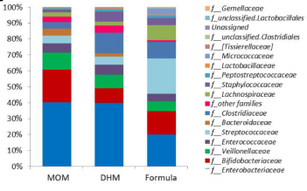
Preterm Gut Microbiome & Feeding Type
MOM:
Greater Bifidobacteriaceae
Lower Staphylococcaceae, Clostridiaceae & Pasteurellaceae than donor milk BUT
Donor Milk:
Closer microbial profile to MOM than preterm formula
Source: Parra-Llorca et.al. Front.Microbiol. 2018

Slide 11
What Is an Exclusive Human Milk Diet (EHMD)?
Diet consisting of 100% Human Milk Derived Products
Mother’s Own Milk (MOM) Preferred
Donor Milk if MOM not available
Only Human Milk Derived Fortifiers (Protein, Fats, Carbohydrates)

Slide 12
Available Human Milk-based Fortifiers
Available in Four Concentrations
Designed to add 4, 6, 8 or 10 calories per ounce to MOM or DM
Caloric Fortifier made from Human Milk Cream also available with 2.5 cal/ml of product

Slide 13
Benefits of an Exclusive Human Milk Diet

Slide 14
Initial Outcomes Centered Around NEC & PN
EHMD had lower rate of NEC than diet of MOM/Donor Milk and Bovine fortifier (Sullivan S. J Pediatr, 2010).
EHMD (Donor Milk/Human Milk Based Fortifiers) had lower PN days and lower NEC (Cristafalo E. J Pediatr, 2013)
EHMD Reduced probability of remaining on PN (Ghandehari H. BMC Research Notes 2012)
EHMD= Exclusive Human Milk Diet; PN= Parenteral Nutrition

Slide 15
The Exclusive Human Milk Diet and NEC
Combined Clinical Trial Data Analysis-Results
5% p=0.002
1% p=0.0003
Incidence of NEC
Incidence of Surgical NEC
“An exclusive human milk diet, devoid of cow milk containing products, was associated with lower mortality and morbidity in extremely preterm infants without compromising growth and should be considered as an approach to nutritional care of these infants.”
Source: Abrams S, et al. Breastfeed Med. 2014;9:29-37. doi:10.1089/bfm.2014.0024.

Slide 16
Other Benefits Beyond NEC

Slide 17
Greater Mortality & Morbidity in Extremely Preterm Infants Fed a Diet Containing Cow Milk Protein Products
EHMD had lower Mortality, NEC, Surgical NEC, Sepsis
“For each 10% increase in the intake of other than an EHMD, the risk of NEC increases by 11.8%, and the risk of surgical NEC increases by 21%....For each 10% increase in the intake of other than an EHMD, there was a 17.9% increase in risk of sepsis.”
Source: Abrams SA, et. Al. Breastfeeding Medicine 2014:9;0:1-5
Notes:
Fortifiers alone add about 20% cow’s milk protein to a baby’s diet

Slide 18
More Human Milk = More Chance of Remaining NEC Free, Combined Clinical Trial Data Analysis
Probability of Remaining NEC Free vs. % Cow Milk-Based Diet
Source: Abrams S, et al. Breastfeed Med. 2014;9:29-37. doi:10.1089/bfm.2014.0024.

Slide 19
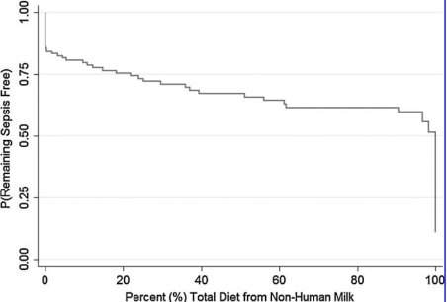
More Human Milk = More Chance of Remaining Sepsis Free, Combined Clinical Trial Data Analysis
Probability of Remaining Sepsis Free vs. % Cow Milk-Based Diet
Source: Abrams S, et al. Breastfeed Med. 2014;9:29-37. doi:10.1089/bfm.2014.0024.

Slide 20
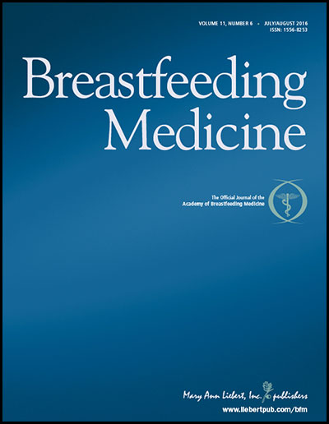
Beyond NEC
Beyond Necrotizing Enterocolitis Prevention:
Improving Outcomes with an Exclusive Human Milk-based Diet
1587 Infants <1250 g
4 Centers in 4 states
Retrospective cohort study
EHMD had Significantly Lower:
NEC
Mortality
Late Onset Sepsis
ROP
BPD
Source: Hair AB, et. al. Breastfeeding Medicine 2016;11(2):1-5.

Slide 21
Beyond NEC
Source: Hair AB, et. al. Breastfeeding Medicine 2016;11(2):1-5.

Slide 22
Exclusive Human Milk Diet & ROP
Small Randomized Trial in Canada (127 Infants)
Avg. 27 weeks, 890 g
Reduction in Severe ROP from 10.7% in Bovine fortifier group to 1.6% in EHMD group (p = 0.04)
Late Onset Sepsis 23% in Bov vs 12.5% in EHM but study too small for significance
Source: O’Connor D. Am J Clin Nutr. 2018;9:1-9.

Slide 24
Herman & Walter Samuelson Children’s Hospital at Sinai
Level 3+ NICU
Community teaching hospital with pediatric residents, but no fellows
Incidence on NEC well within VON incidence
Length of Stay at lower end of VON
Stable neonatology attending staff
Dedicated NICU Lactation Consultant
Did not have Donor milk or Human milk-based fortifier at start of study
Made decision to use EHMD

Slide 25
Why Adopt EHMD?
AAP recommendations on the use of Human Milk in Premature Infants
NEC rate within VON rate, but on high end (babies <1250 g)
Extreme LOS for some babies, but overall on low end of VON
Horrific case of uncomplicated 27-week infant with NEC, subsequent short bowel syndrome & eventual death at 8 months of age from sepsis and liver failure
Human/Family costs

Slide 26
Study Design
EHMD qualifying criteria: BW < 1250 grams or <29 weeks (Babies at high risk of NEC and extreme LOS)
Breast Milk Feeds started at ~10-20 ml/kg/day on day 1-2
Bolus feeds, not continuous (due to fat loss in tubing)
EHMD started March 1, 2012
Donor milk used if mother cannot or will not express milk
Human Milk Based fortifier started at 120 ml/kg/day feeds (keeping feeding protocol consistent throughout study period)
Nurses mix milk and fortifier in milk room (one bottle at a time, not entire 24 hr. period) Maryland is a tissue license state, so BDRs and individual milk bottle log in required
Babies given Donor milk (as needed) and Human Milk Based fortifier until 34 weeks gestational age, then weaned gradually over 4 days

Slide 27
Study Design (continued)
Groups
Group H: Exclusive human milk (Mother’s or Donor)
Group B: Mother’s milk + bovine-based fortifier
Group M: Combination mother’s milk, bovine-based fortifier, and formula
Group F: Formula only
Notes:
Just of note we initiated exclusive human milk diet into the NICU group (when we obtained approval for donor milk and human milk based fortifier)

Slide 28
Definitions
Time to full feeds: Time from birth until receiving 150 mL/kg/day feeds
Feeding intolerance: Feeds interrupted and held for greater than 24 hours

Slide 29
Results
 | N=293
 | Human | Bovine | Mixed | Formula
Total | 87(30%) | 127 (43%) | 49 (17%) | 30 (10%)
ROP | 11 (14%) | 40 (32%) | 19 (40%) | 4 (14%) | <0.001
Sepsis | 1 (1.2%) | 3 (2.3%) | 3 (6.1%) | 0 (0%) | 0.545
BPD | 13 (15%) | 30 (24%) | 21 (42%) | 3 (10%) | <0.001
GA wks (+/-SD) | 27.7(±2.7) | 28.3(±2.8) | 27.6(±2.8) | 29.8(±2.5) | <0.002
Growth Velocity g/kg/d (+/-SD) | 11.6(±2.7) | 11.6 (±2.5) | 11.2(±3.0) | 12.1(±3.2) | 0.377

Slide 30
Feeding Intolerance: Number of Times Feeds Held for >24 Hrs
Groups

Slide 31
Additional Days to Full Feeds
P=0.0001

Slide 32
Additional Days of Hospitalization
P=0.374

Slide 33
Incidence of Necrotizing Enterocolitis (<1250 g)

Slide 34
Additional Hospital Cost (283 Infants)
P=0.004
P=0.175
Human group includes cost of donor milk and fortifier products
Notes:
Robust regression which down-weights observations with undue influence (Mixed group was also increased) also significant

Slide 35
Additional Physician Charges (293 Infants)
Human group includes cost of donor milk and fortifier products

Slide 36
Additional Decreased Cost & Improved Feeding Tolerance in VLBW Infants Fed an Exclusive Human Milk Diet (EHMD): A Reanalysis of the Data
Maushumi Assad, MD, MPH, Joseph H. Abraham, ScD, & Melinda J. Elliott, MD, FAAP
Herman and Walter Samuelson Children’s Hospital at Sinai
Baltimore, MD
Source: INAC Platform Presentation. Lyon, France. July 2017.

Slide 37
Increased Time to Full Feeds (Adjusted for Gestational Age)
p<0.007
p=0
p<0.004

Slide 38
Total Cost Difference After Paying for EHMD Products
P=0.031
P=0.850
NS
P=0.496
NS

Slide 39
Remember Feeding Intolerance? (Number of Times Feeds Held for >24 Hrs)
Groups

Slide 40
Increased Cost Due to Feeding Intolerance (per patient, adjusted for gestational age, excluding NEC)
$29,661
P=0.023

Slide 41
Growth Is Important!

Slide 42
Feeding Guidelines
Early enteral feedings and Standardized approach to feeding
Improve Intestinal Motility
Stimulate Intestinal Hormonal Response
Improve Feeding Tolerance
Promote earlier achievement of full feeds
Decrease problems related to prolonged TPN
Babies can safely be fed more rapidly with the EHMD!
Notes:
No gastric hormone response if on continuous feeds.

Slide 43
Human Milk Feeding Supports Adequate Growth in Infants ≤ 1250 Grams Birth Weight
Prospective Observational Study, Single Center
Mean BW 913 g, Mean GA 27.6 weeks
Feeds started within 24 hours of birth at 20 ml/kg/day MOM or DM
Fortify to +4 at 60 ml/kg/day, +6 at 80-100 ml/kg/day, +8 if weight gain <15 g/kg/day, Wean at 34 weeks
Source: Hair AB, et. al. BMC Research Notes ;2013(6):459

Slide 44
Human Milk Feeding Supports Adequate Growth in Infants ≤ 1250 Grams Birth Weight
Lower Rate Extrauterine Growth Restriction (22%, excluding those SGA at birth)
Mean 8.4 days to regain birthweight
Mean Weight Gain of 25 g/kg/day
Mean Length gain 0.99 cm/wk
Mean HC gain 0.72 cm/wk
SGA babies had same growth velocity as AGA babies, but remained SGA
Improved over Bovine or Later fortification
(Same as Bovine or Later fortification)
Source: Hair AB, et. al. BMC Research Notes ;2013(6):459

Slide 45
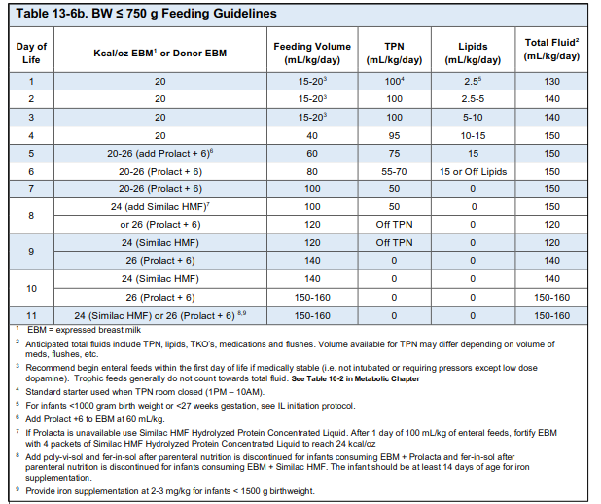

Slide 46
Premature Infants 750–1,250 g Birth Weight Supplemented With a Novel Human Milk-Derived Cream are Discharged Sooner
Prospective, Randomized Trial
27.7 weeks, BW 973 +/- 145 grams
Standardized EHMD Feeding Protocol Both Groups
Cream Group received Human Milk Caloric Fortifier if MOM/DM <20 cal/oz
Cream Group had Lower Post-Menstrual Age at Discharge and Shorter LOS
Babies with BPD Seemed to do even Better
BPD Cream Study ongoing now
Source: Hair A, et al. Breastfeeding Medicine. 2016:11(3)DOI: 10.1089/bfm.2015.0166

Slide 47
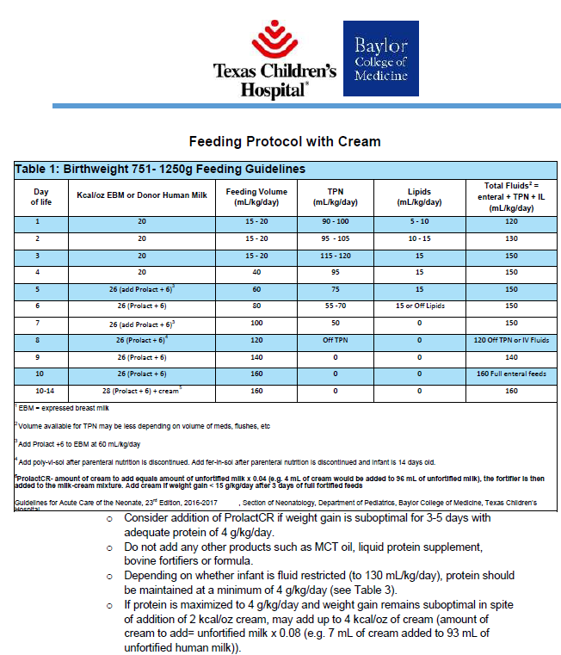
Texas Children’s Hospital—
Sample Feeding Protocol: 751-1250 g

Slide 48
Growth at Sinai: Initial Study
Study had unchanged growth, but we did not change our feeding protocol (we still were using our bovine brains)!
Mean weight gain 19 g/day
Mean weight gain velocity 12 g/kg/day, no different from bovine, but not good enough in 2016!

Slide 49
Sinai Revised Feeding Protocol
Infants < 1250 grams or <29 weeks:
Start feeds within 24-48 hours
Advance feeds daily by 10-20 ml/kg/day
Fortify with Human Milk Based Fortifier +6 when feeds reach 60 ml/kg/day feeds
Feeding volume goal 160 ml/kg/day, unless medically contraindicated
Add Human Milk Caloric Fortifier when at 100 ml/kg/day fortified feeds if using only HMBANA donor milk (no MOM)
Add Human Milk Caloric Fortifier if, after 3 days full volume fortified feeds, weight gain less than optimal; Increase as needed

Slide 50
Effects of a Standardized Feeding Protocol on Weight Gain in Very Low Birth Weight Infants
Adopted more appropriate standardized feeding protocol with EHMD to improve growth
Average weight gain in this population 23 g/day
Average head circumference increase: 0.86 cm/wk
Average length increase: 0.97 cm/wk
Source: Swerdfeger, Elliott. Presented at Region 4 Academic Pediatric Association Conf. 2017.
Charlottesville, VA

Slide 51
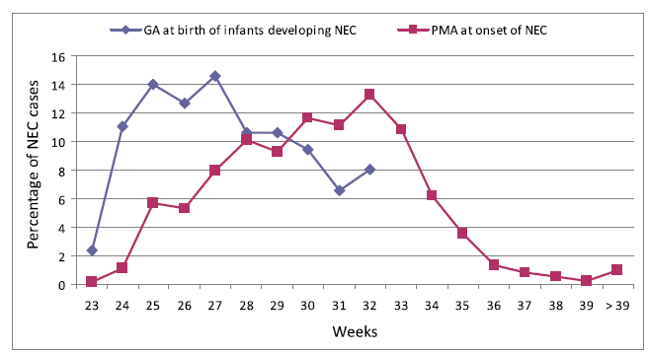
Incidence & Timing of Presentation of Necrotizing Enterocolitis in Preterm Infants
NEC presents at mean age of 7 days in more mature infants.
NEC delayed to 32 days of age in smaller, lower GA infants.
Distribution of cases of NEC according to GA and postmenstrual age (PMA) in the study cohort. Source: Yee, et. al. Pediatrics. 2012

Slide 52
Improving Growth for Infants 1250 Grams Receiving an Exclusive Human Milk Diet
Legacy Randall Children’s Hospital
Table 4. Growth and Clinical Data for Donor Human Milk Era 2/Bov Fortifier (Mean ± SD or Proportion) (Formal Protocol)
Table 5. Growth and Clinical Data for Exclusive Human Milk Era 2 (Mean ± SD or Proportion) (+4 at 40 ml/kg/day feeds)
HMBF 2
N | 111
PMA, weeks | 27.1 ± 2.0
Birth weight, g | 959 ± 174
Weight gain, g/kg/d | 14.1 ± 1.8
Length gain, cm/wk | 1.03 ± 0.23
Head circ gain, cm/wk | 0.79 ± 0.18
EHM 2
N | 94
PMA, weeks | 26.6 ± 2.4
Birth weight, g | 904 ± 200
Weight gain, g/kg/d | 13.6 ± 1.6
Length gain, cm/wk | 1.06 ± 0.19
Head circ gain, cm/wk | 0.81 ± 0.15
Source: Huston RK, et. al. Nutrition in Clinical Practice; DOI: 10.1002/ncp.10054. 2018.

Slide 53
Optimizing Nutrition: Mother’s Own Milk (MOM)
Support Mother’s Own Milk
Education of Family:
Milk is Medicine
Risks of Not Receiving Human Milk
Dedicated NICU Lactation Consultant with flexible schedule

Slide 54
Optimizing Nutrition: MOM
Establish and Maintain Supply
Frequent skin-to-skin contact
Pumping at bedside
Early post-delivery expression (Teach breast massage and hand expression)
Early feeding (first hours to day) and mouth care with colostrum
Provide pumping log/diary/App (PeekABoo ICU or other app)
Inquire at regular intervals “How is pumping going?”
Track Maternal Supply to intervene if noted to be decreasing
Non-nutritive Breastfeeding

Slide 55
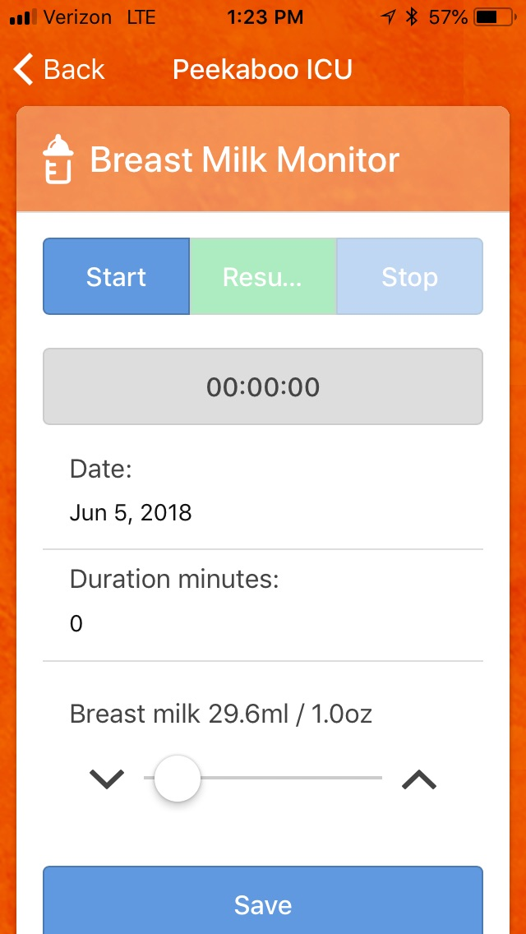
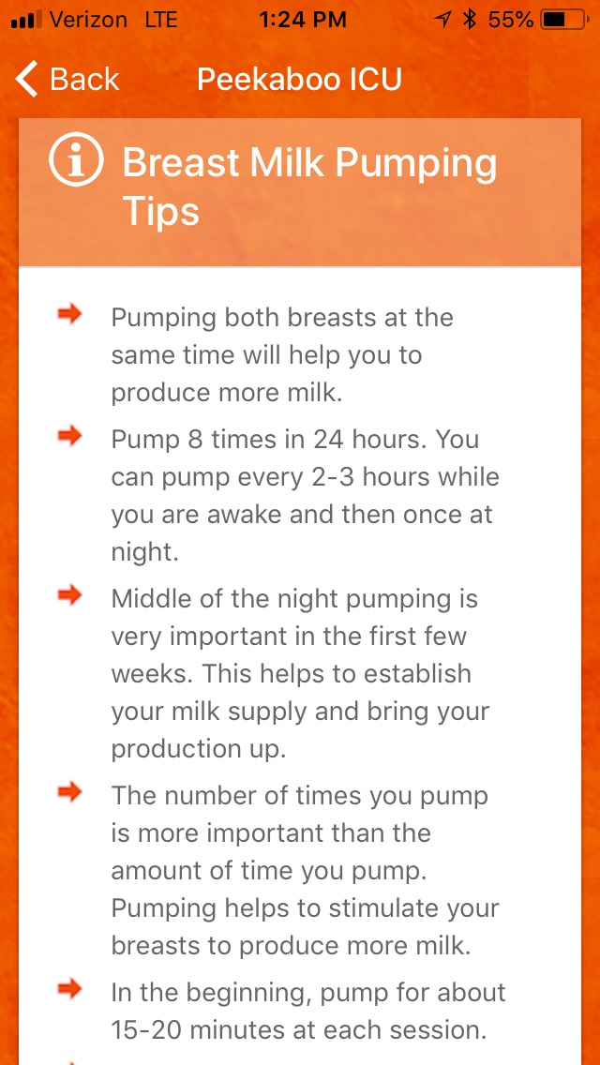
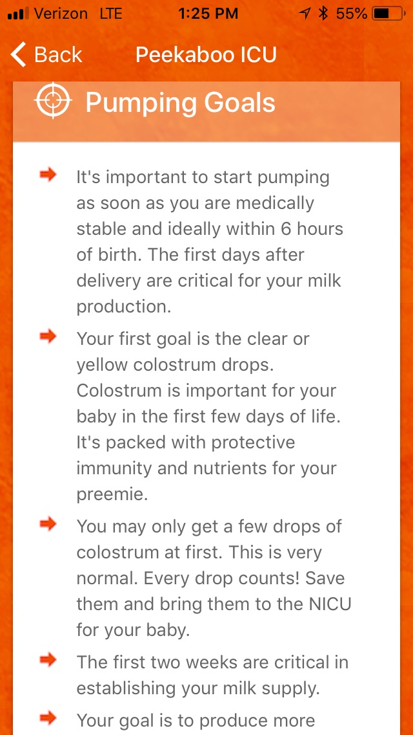
Peekaboo ICU

Slide 56
Optimizing Nutrition: Protein Content
Product | Protein/100 ml mixed with Preterm Milk** | Protein/100 ml mixed with Term Milk** | Protein/150 ml mixed with Preterm Milk** | Protein/150 ml mixed with Term Milk**
H2MF+4 | 2.3 | 2.1 | 3.5 | 3.2
H2MF+6 | 2.8 | 2.6 | 4.2 | 3.9
H2MF+8 | 3.2 | 3.1 | 4.8 | 4.6
H2MF+10 | 3.7 | 3.6 | XXXX | XXXX
**Preterm Milk Assumes Protein of 1.4 g/100 ml
**Term Milk Assumes Protein of 1.1 g/100 ml
If protein load well over 4 g/kg/day, Renal injury is possible and growth may be poor.

Slide 57
Optimizing Nutrition
Bolus feeds best over slow pump flow rates or continuous feeds
Increased fat loss with tubing (Kangaroo pump worse than syringe pump)
H2MF and/or Cream improve fat delivery even with continuous feeds
Cream shown to shorten Length of Stay in 750-1250g infants (not specifically studied yet in <750g group)
Substantial Calcium and Phosphorus losses with continuous feeds, minimized in vitro with Human milk based fortification (no direct CaPhos salt loss as in bovine fortified milk)
Estimated calorie loss ranged between 3 kcal/kg/day to 25 kcal/kg/day depending on fortifier and feeding method

Slide 58
Fortifier & Cream Improve Fat Delivery in Continuous Enteral Infant Feeding of Breast Milk
Source: Tabata, et.al. 2015

Slide 59
Optimizing Nutrition
Length of Feeding Tubing?
The longer the tubing, the more human milk fat that get stuck to it. If the calories are getting stuck in the tubing, the baby isn't getting them in his/her feeding.
The syringe position (when the feeding is given via a pump)?
Fat is a necessary nutrient. Fat rises to the top which means that the syringe tip facing up, will allow for maximal fat to be delivered to the patient.
Are the feeds bolus or continuous?
Continuous feeds allow for more fat sticking to the tubing and less fat getting to the baby.
How often are feeding tubes changed?
Frequently, new tubes will give a greater new surface area for the fat to stick to which leads to loss of nutrition.
All can contribute to poor weight gain!

Slide 60
Long-term Benefits

Slide 61
Breast Milk Consumption in Preterm Neonates & Cardiac Shape in Adulthood
30 former preterm (gestational age ~30 weeks) infants born 1982-85. Now 23-28 years old.
30 EHMD, 16 Formula
Compared with Term Controls
Cardiac Morphology & Function assessed by MRI
Source: Lewandowski AJ, Lamata P, Francis JM, et al. Breast Milk Consumption Preterm Neonates and Cardiac Shape in Adulthood. Pediatrics. 2016;138(1):e20160050

Slide 62
Breast Milk Consumption in Preterm Neonates & Cardiac Shape in Adulthood
Source: Lewandowski, AJ, Lamata P, Francis JM, et al. Breast Milk Consumption Preterm Neonates and Cardiac Shape in Adulthood. Pedoatrics. 2016; 138(1):e20160050

Slide 63
Breast Milk Consumption in Preterm Neonates & Cardiac Shape in Adulthood
EHMD fed patients had increased Left and Right Ventricular end-diastolic volume index and stroke volume index compared with preterm-born individuals who were exclusively formula fed as infants
Both smaller than term controls, but EHMD group reduction only 9% compared to 18% for Formula fed group
Source: Lewandowski, AJ, Lamata P, Francis JM, et al. Breast Milk Consumption Preterm Neonates and Cardiac Shape in Adulthood. Pedoatrics. 2016; 138(1):e20160050

Slide 64
5-year Outcomes of an Exclusive Human Milk Diet: Growth, Body Composition & Neurodevelopment
Source: Bergner, et. al. PAS Poster Presentation. Toronto, ON, CA. 2018

Slide 65
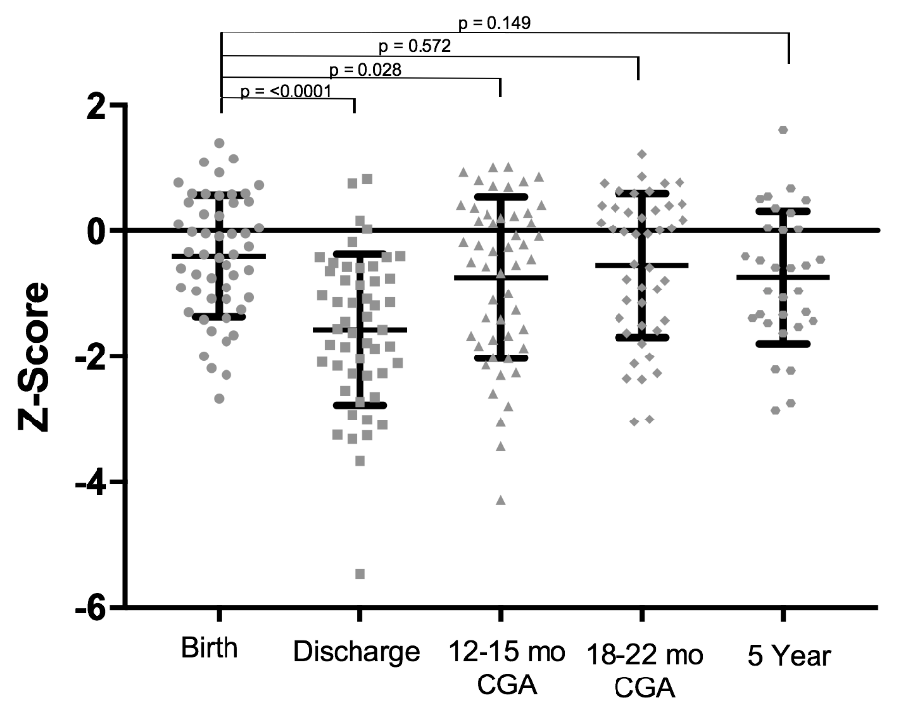
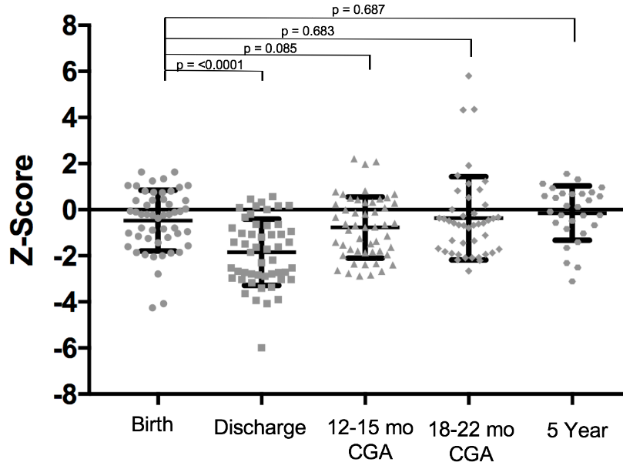
5-year Outcomes of an Exclusive Human Milk Diet: Growth
Weight
Length
Source: Bergner, et. al. PAS Poster Presentation. Toronto, ON, CA. 2018

Slide 66
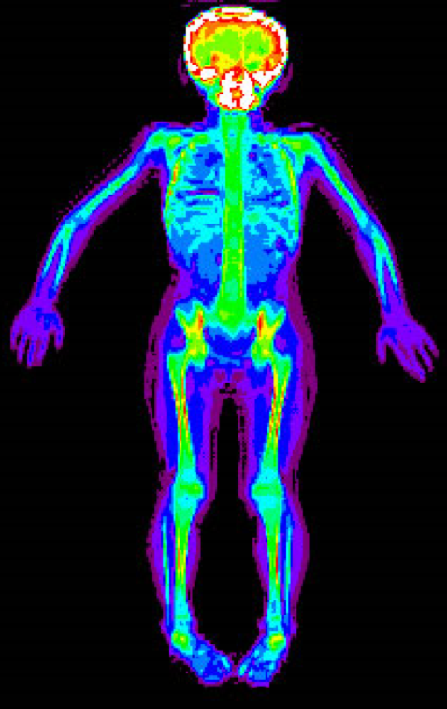
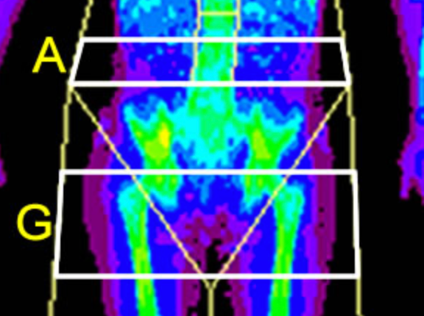
5-year Outcomes of an Exclusive Human Milk Diet: Body Composition
 | Exclusive HM Cohort (n=31) | Matched Term Controls (n=31) | p-value
Age (y) | 5.3 ± 0.2* | 5.3 ± 0.8 | 0.904
Weight (kg) | 17.4 ± 2.4 | 17.5 ± 2.0 | 0.835
Height (cm) | 108.9 ± 5.5 | 108.7 ± 5.5 | 0.832
Bone Mineral Content (g) | 659.7 ± 87.6 | 646.7 ± 72.8 | 0.448
Bone Mineral Density (g/cm²) | 0.63 ± 0.05 | 0.62 ± 0.05 | 0.736
Fat Mass (kg) | 4.25 ± 1.16 | 4.25 ± 0.89 | 0.998
Fat Mass Index (kg/m²) | 4.14 ± 1.39 | 4.23 ± 0.76 | 0.765
% Fat | 24.0 ± 4.7 | 23.7 ± 4.6 | 0.801
Lean Mass (kg) | 12.78 ± 1.78 | 13.05 ± 1.75 | 0.402
Lean Mass Index (kg/m²) | 10.69 ± 2.62 | 10.94 ± 0.80 | 0.581
Android : Gynoid Ratio | 0.55 ± 0.09 | 0.55 ± 0.10 | 0.826
Trunk : Leg % Fat Ratio | 0.64 ± 0.06 | 0.64 ± 0.08 | 0.883
Trunk : Limb Fat Ratio | 0.73 ± 0.11 | 0.67 ± 0.09 | 0.025
Appendicular Fat Free Mass (kg/m²) | 3.89 ± 1.00 | 4.15 ± 0.49 | 0.156
Source: Bergner, et. al. PAS Poster Presentation. Toronto, ON, CA. 2018

Slide 67
5-year Outcomes of an Exclusive Human Milk Diet: Neurodevelopment
 | Exclusive HM Composite Index Score (n=31) | Standard Score Range of the Mean | Composite Index Score <70† n (%)
Verbal Comprehension | 95 ± 25* | Average | 3 (10)
Visual Spatial | 95 ± 40 | Average | 1 (3)
Fluid Reasoning | 97 ± 46 | Average | 3 (10)
Working Memory | 94 ± 38 | Average | 1 (3)
Processing Speed | 94 ± 41 | Average | 3 (10)
Full Scale Intelligence Quotient (IQ) | 93 ± 38 | Average | 3 (10)
Source: Bergner, et. al. PAS Poster Presentation. Toronto, ON, CA. 2018

Slide 68
Important to Remember:
Provide good lactation support to Mom
Develop a Protocol and try to stick to it as a group
Administration will want to see outcomes, so keep your data
Feed & fortify early for best growth
Ensure adequate protein intake (~4 g/kg/day, Concentrate protein in PN as you wean volume)
Bolus feed as possible for best growth

Slide 70
References
Bergner, et. al. 5 Year Outcomes of an Exclusive Human Milk Diet: Growth, Body Composition, and Neurodevelopment. PAS Poster Presentation. Toronto, ON, CA. 2018
Bisquera JA, Cooper TR, Berseth CL. Impact of necrotizing enterocolitis on length of stay and hospital charges in very low birth weight infants. Pediatrics. 2002; 109: 423-42.
Sullivan S, et. al. An Exclusive Human Milk-Based Diet IS Associated with a Lower Rate of Necrotizing Enterocolitis that a Diet of Human Milk and Bovine Milk-Based Products. J Pediatr. 2010;156:562-7.
Rogers SP, et.al. Continuous Feedings of Fortified Human Milk Lead to Nutrient Losses of Fat, Calcium and Phosphorous. Nutrients. 2010: 2: 230-240.
Viadyanathan G, Hay JW, Kim JH. Cost of necrotizing enterocolitis and cost-effectiveness of exclusively human milk based products in feeding extremely premature infants. Breastfeed Med. 2011; 6: 1-9.
Neu J, Walker AW. Necrotizing Enterocolitis. N Engl J Med. 2011; 364: 255-64.
Ganapathy V, et.al. Costs of Necrotizing Enterocolitis and Cost-Effectiveness of Exclusively Human Milk-Based Products in Feeding Extremely Premature Infants. Breastfeeding Med.2012;7:29-37.
Breastfeeding and the Use of Human Milk. AAP Policy Statement. Pediatrics. 2012;129(3):e827-e841.
Bhatia, J. Human milk and the premature infant. Ann Nutr Metab. 2013; 62 (suppl. 3): 8-14.
Cristofalo EA, et.al. Randomized Trial of Exclusive Human Milk versus Preterm Formula Diets in Extremely Premature Infants. J Pediatr. 2013;163:1592-5.
Hair AB, et. al. Human milk feeding supports adequate growth in infants ≤ 1250 grams birth weight. BMC Research Notes.2013;6:459
Meredith-Dennis L, et. al. Composition and Variation of Macronutrients, Immune Proteins, and Human Milk Oligosaccharides in Human Milk From Nonprofit and Commercial Milk Banks. J Hum Lact. 2017; DOI: 10.1177/0890334417710635.

Slide 71
References
Parra-Llorca, et.al. Preterm Gut Microbiome Depending on Feeding : Significance of Donor Human Milk.Front.Microbiol. 2018;DOI:10.3389/fmicb.2018.-1376.
Patel AL, et. Al. Impact of Early Human Milk on Sepsis and Health-Care Costs in Very Low Birth Weight Infants. J Pernatol. 2013;33:514-519.
National Center for Health Statistics. March of Dimes Peristatistics, 2013. http://www.marchofdimes.com/Peristats/pdflib/195/99.pdf. Accessed September 29, 2014.
Abrams SA, et. Al. Greater Mortality and Morbidity in Extremely Preterm Infants Fed a Diet containing Cow Milk Protein Products. Breastfeeding Medicine. 2014;9:1-5
Huston RK, et. al. Decreasing Necrotizing Enterocolitis and Gastrointestinal Bleeding in the Neonatal Intensive Care Unit The Role of Donor Human Milk and Exclusive Human Milk Diets in Infants <1500 g Birth Weight. ICAN: Infant, Child, & Adolescent Nutrition.2014;6(2):86-93.
Zhou J, et. Al. Human Milk Feeding as a Protective Factor for Retinopathy of Prematurity: A Meta-analysis. Pediatrics. 2015;136(6):e1576-e1586.
Tabata M, et.al. Fortifier and Cream Improve Fat Delivery in Continuous Enteral Infant Feeding of Breast Milk. Nutrients. 2015; 7: 1174-1183.
Assad M, Elliott MJ, Abraham JH. Decreased Cost and Improved Feeding Tolerance in VLBW Infants Fed an Exclusive Human Milk Diet. J Perinatol. 2016;36:216-220.
Hair AB, et.al. Premature Infants 750–1,250 g Birth Weight Supplemented with a Novel Human Milk-Derived Cream Are Discharged Sooner. Breastfeeding Medicine. 2016;11(3):133-137.
Hair AB, et.al. Beyond Necrotizing Enterocolitis Prevention: Improving Outcomes with an Exclusive Human Milk-Based Diet. Breastfeed Med.2016:11(2):1-5.
Lewandowski AJ, et al. Breast Milk Consumption in Preterm Neonates and Cardiac Shape in Adulthood. Pediatrics. 2016;138(1):e20160050.

