Slide 1
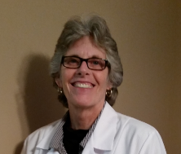


Improving Patient Outcomes & Decreasing Hospital Costs Through Nutrition
A webinar for HealthTrust members, co-sponsored by Abbott
November 1, 2018

Slide 2
Learning Objectives
At the end of this session, the attendee will be able to:
Describe the importance of a complex nutrition protocol and its impact on clinical quality outcomes, including morbidity, mortality and readmissions
Recall a process to implement, monitor and evaluate the effectiveness of a comprehensive malnutrition program
Explain how to lead an interdisciplinary team to promote best practices and implement strategies used to improve data collection and enhance reimbursement

Slide 3

Amanda Goldman, MS, RD, LD, FAND
System Director, Quality & Wellness
CHI Food & Nutrition Services
Director, Diabetes & Nutrition Care
KentuckyOne Health
3
Notes:
Amanda Goldman obtained her B.S. in Dietetics from Miami University and her M.S. in Clinical Nutrition from the University of Kentucky. She completed her dietetic internship at the University of Kentucky Hospital. Amanda is currently the System Director of Quality & Wellness for the Catholic Health Initiatives Food & Nutrition Services national program. Prior to this role, Amanda served as a Regional Director and as a Food Service Director. Along with her current position, she also leads the Diabetes & Nutrition Care program for KentuckyOne Health. Amanda is a Past-President of the Kentucky Academy of Nutrition and Dietetics and is a Past Chair for the Management in Food & Nutrition Systems dietetic practice group of the Academy of Nutrition and Dietetics.

Slide 4

Catholic Health Initiatives
Who We Are
Third largest non-profit health system in the United States
CHI facilities located in 18 states through 100 hospitals and clinics
Over 90,000 employees
Continually striving to Build Healthier Communities

Slide 5
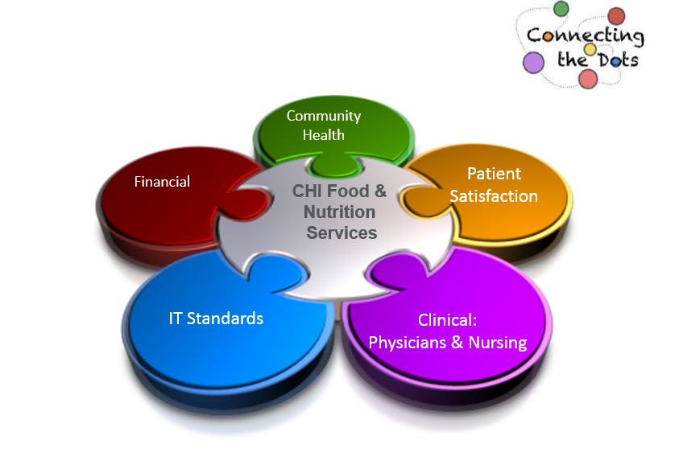
Integration: Key to Success

Slide 6
Malnutrition
Definition: The unhealthy condition that results from not eating enough food or not eating enough healthy food; poor nutrition
Acute Care Setting:
  Impacts approximately 30-50% of hospitalized patients
  Recent research is showing some results even higher than 50%
  Typically only 3% of those patients have a documented medical diagnosis of malnutrition
  During 2015, less than 2% of KentuckyOne Health (multi-hospital system) patients had a documented medical diagnosis of malnutrition
  Sources: 1. Coats KG et al. J Am Diet Assoc.1993;93:27-33. 2. Giner M et al. Nutrition.1996;12:23-29. 3. Thomas DR et al. Am J Clin Nutr.2002; 75:308-313. 4. Somanchi M et al. JPEN. 2011;35:209-216. 5. Guigoz Y. J Nutr Health Aging. 2006;10:466-487. 6. Jensen GL, et al. JPEN J Parenter Enteral Nutr. 2010;34:156-159.

Slide 7
Impact of Malnutrition
Hospital-acquired
Conditions
Hospital-acquired
Infections
Readmissions
Increases risk for falls
2 times more likely to develop a pressure ulcer
2.5 times the risk for SSI
5.1 times more likely to develop a UTI
Increased risk for readmissions—Patients are 3 to 4 times more likely to be readmitted
Notes:
Elderly
Oncology
Crohn's Disease
Pancreatitis
ETOH Abuse
Surgery
Severe Trauma
Malnutrition Increases:
Mortality & Morbidity
Length of Stay
Recovery Time
Overall Healthcare Cost
Factors that Increase Risk:
Medical
Psychological
Social

Slide 8
Diagnostic Criteria for Identifying Malnutrition:
Based on the 2012 Consensus Statement by the Academy of Nutrition and Dietetics and the American Society of Parenteral and Enteral Nutrition
Unintentional Weight Loss
Reduced Nutritional Intake
Nutrition-focused Physical Assessment
Subcutaneous Fat Loss
Lean Body Mass Loss
Fluid Accumulation
Reduced Grip Strength

Slide 9
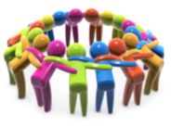
Stakeholders
Who will help share the vision and champion the process?
If nursing is to support the malnutrition identification process, include a nurse champion along with a clinical nutrition lead
Consider including the following:
Registered Dietitian
Nurse
Discharge Planning
CDI Team
Coding Team
Quality Management
Wound Therapy
Administrative Support
Physician
IT
Medical Home
Other
Notes:
Identify the scope of initiating a malnutrition screening/identification process
Identify stakeholders and form a steering committee
Create an adaptive timeline
Incorporate plan for monitoring and maintenance
Identify how a malnutrition identification process (EMR/paper) will be implemented
Determine what IT resources are needed
Determine how training would be provided to clinical nutrition team
Determine what aspects will FNS need to collaborate and share with other departments
Determine what physical resources are needed (hand dynamometer, measuring tape, gloves)
Determine how program effectiveness and outcomes will be monitored

Slide 10
Comprehensive Malnutrition Platform
Across Disciplines
Inclusive Approach
  Identify malnourished patients using evidence-based standards; Assists physicians with determining type and severity of malnutrition
  Comprehensive documentation protocols for multidisciplinary team
  Training for dietitians and other team members
Complements the use of the CHI Malnutrition Screening Tool
Assists with enhancing reimbursement back to individual facilities
Outcomes and impact on readmissions are tracked and reported to leadership
Decreased risk during a RAC Audit (Recovery Audit Contractors)
Clinical Dietitians increase their skill set to provide improved care

Slide 11
Platform Features
Through Planning & Implementation
Clinical Dietitian Training
  Nutrition-Focused Physical Assessment Workshop
    Classroom Training and Skills Training
Program Policy & Procedure
Outcomes and Tracking
Program Compliance Audits
Training also offered to:
  Physicians
  Nursing
  Clinical Documentation Specialists and Coders

Slide 12
Malnutrition: CDI & Coding
Collaboration
Why is it important?
  Provides an accurate picture of the patient’s condition
  Supports the interdisciplinary care provided to patients
  Ensures appropriate reimbursement for facility as reimbursement may change due to specific conditions or issues that arise
    Comorbidity – Pre-existing condition that impacts treatment and increases length of stay
    Complication – Arises during acute-care stay and increases length of stay
  DRG (diagnostic-related group) assignment determines financial reimbursement
    Secondary diagnoses can also impact reimbursement
      Comorbidity and complication (CC)
      Major comorbidity and complication (MCC)

Slide 13
Malnutrition Program Effectiveness
  How will you maintain the integrity of your program?
  Ensure proper monitoring system is in place
  Recognize areas of opportunity
    Is the clinical team documenting characteristics appropriately and consistently?
    Does your audit tool provide what you need?
    Are physicians acknowledging your documentation?
    How are you impacting readmissions and other clinical outcomes?
  Recognize further need for training to increase competence/confidence

Slide 14
Sharon Siegel, RD, LD
System Clinical Nutrition Manager, Louisville
KentuckyOne Health & University of Louisville Hospital
Sharon Siegel, RD, LD
Sodexo System Clinical Nutrition Manager, Louisville
KentuckyOne Health & University of Louisville Hospital
Notes:
Sharon Siegel is a System Clinical Nutrition Manager with Sodexo. She leads the clinical nutrition team at the University of Louisville Hospital and the Western Market of KentuckyOne Health hospital system, a division of Catholic Health Initiatives. She earned a Bachelor’s Degree in Nutrition and Dietetics from Louisiana State University, and is obtaining her Master of Business Administration from LSU. Sharon has over 25 years of experience as a Registered Dietitian in healthcare, and currently serves as the Secretary of the Kentucky Society for Parenteral and Enteral Nutrition.

Slide 15
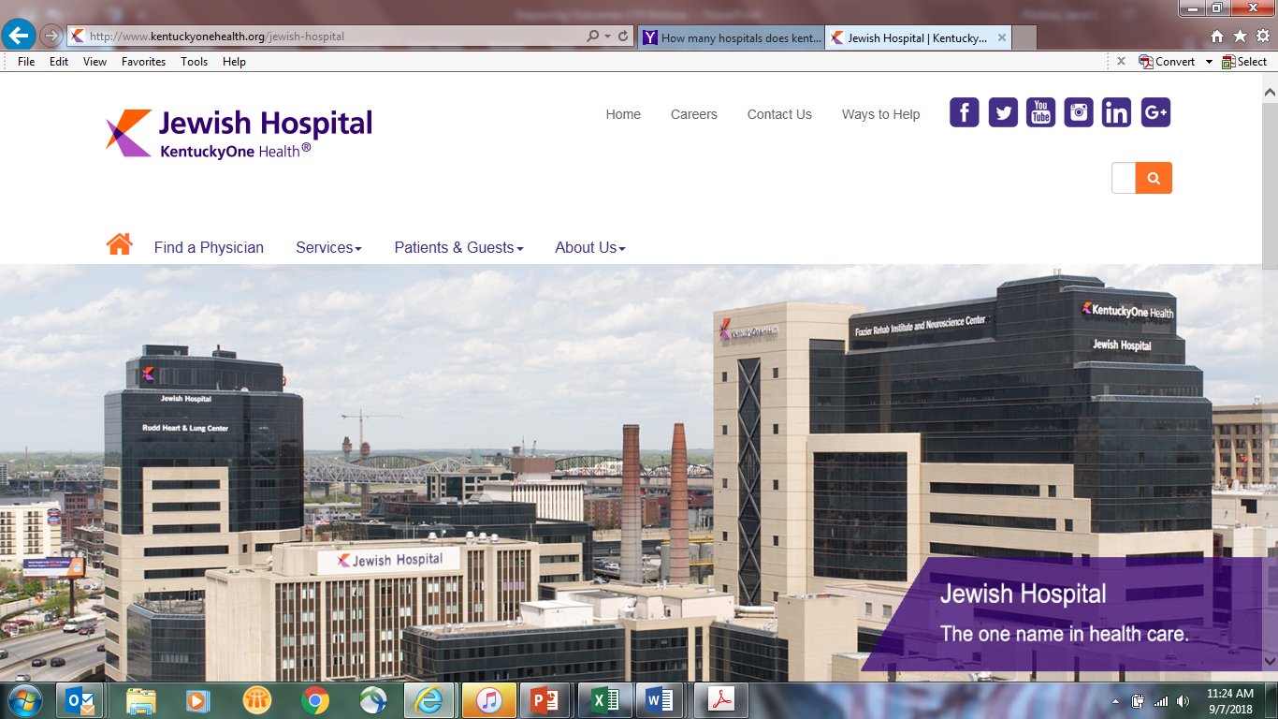

KentuckyOne Health
Who We Are:
Located in:
  Kentucky
Owned by:
  Catholic Health Initiatives
KentuckyOne Health:
  11 Hospitals
  More than 200 total locations including hospitals, physician groups, clinics, primary care centers, specialty institutes and home health agencies
Notes:
KentuckyOne Health, one of the largest and most comprehensive health systems in the Commonwealth, has more than 200 locations, including hospitals, physician groups, clinics, primary care centers, specialty institutes and home health agencies in Kentucky and southern Indiana. KentuckyOne Health is dedicated to bringing wellness, healing and hope to all, including the underserved.

Slide 16
Our Story
2012: ASPEN/AND Consensus statement regarding identification and documentation of adult malnutrition
2013: MST added to Electronic Medical Record as a screen for malnutrition
2013: ONS policy implemented at Jewish Hospital as an action step after Falls Audit; Saint Joseph Hospital and other KentuckyOne facilities follow
2014: ICD-10 multi-facility Task Force initiated to review coding of malnutrition as it relates to outcomes
2015: Dietitians trained in nutrition-focused physical assessment
2016: Malnutrition coding initiated
2018: Research study completed on impact of nutrition-focused quality improvement initiatives among hospitalized malnourished patients, and presented at three poster sessions

Slide 17
Desired Outcomes of Malnutrition Initiative
Reduce 30-day all-cause readmission rates
Decrease length of hospital stay
Promote quality outcomes and lessen patient adverse health events
Improve patient care with prompt nutrition intervention

Slide 18
Steps for Addressing Malnutrition
Step 1
Recognize and Identify Malnutrition Risk
Step 2
Implement Early Nutrition Intervention
Step 3
Develop a Discharge Plan

Slide 19
Malnutrition Policy
Notes:
Purposes:
To identify patients who are malnourished or at risk for malnutrition in a timely manner.
To quickly implement nutrition interventions that will positively impact quality of life.
To provide patients with discharge plans for ongoing nutrition therapy following discharge.

Slide 20
Nursing Protocol for Nutrition Intervention
Patients are screened within 24 hours of admission for malnutrition risk using the Malnutrition Screening Tool
If the MST identifies a patient at risk for malnutrition by a score of > 2, consult to Registered Dietitian is generated, and RN initiates Oral Nutrition Supplement based on the Oral Supplement Algorithm
If no risk identified by a score of 2 or greater, no supplement is ordered
Oral nutrition supplement provided 2 x a day (does not require a physician or provider order)
Stop
RD completes assessment per policy
Decisions for supplement changes and other nutrition interventions made by the RD during assessment

Slide 21
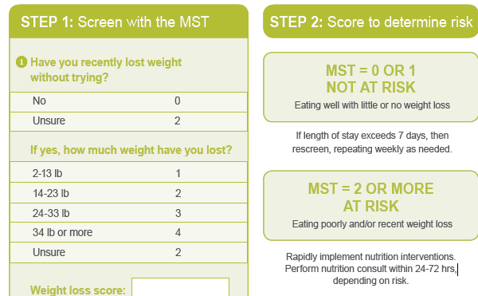
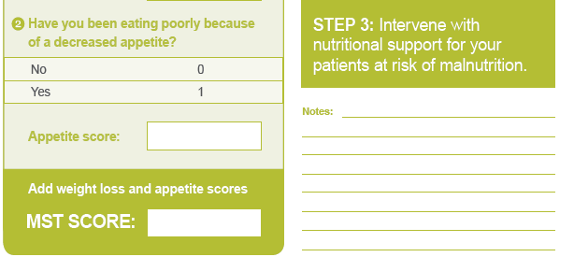
Malnutrition Screening Tool (MST)

Slide 22
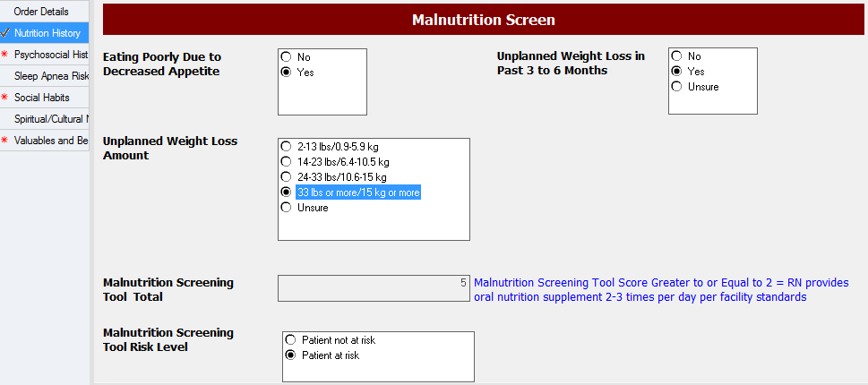
Admission History
Actions:
RN opens Admission History in Cerner to initiate malnutrition screening.
RN screens patient for nutrition risk utilizing the MST.

Slide 23
Oral Nutrition Supplement (ONS) Decision Tree

Slide 24

Recognize & Identify Risk
Actions:
Respond to Task to Follow Oral Supplement Algorithm (Decision Tree)

Slide 25

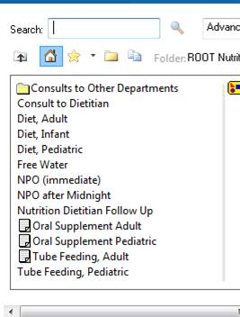
Implement Early Nutrition Intervention
Actions:
Respond to Order Supplement
Order Supplement

Slide 26
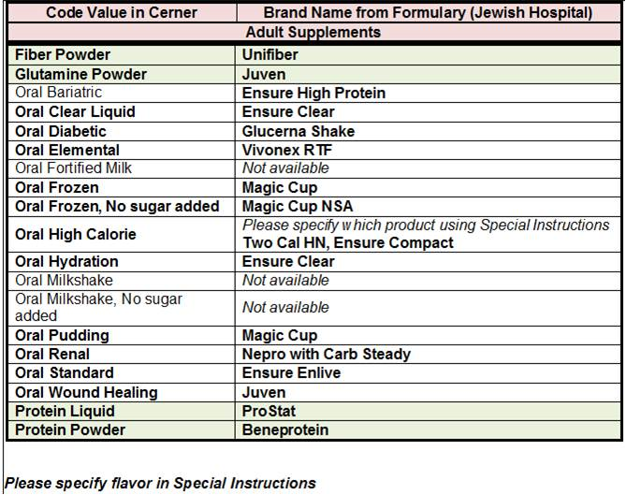
Implement Early Nutrition Intervention
Actions:
1. Order Oral Nutrition Supplement based on Reference Text and diet order

Slide 27
Implement Early Nutrition Intervention
Actions:
RN is tasked to order ONS order upon completion of RN screening
  ONS order is based on diet ordered per Protocol
Cerner auto generates consult to Dietitian
Dietitian initiates nutrition care process
  Completes a nutrition assessment
  Recommends nutrition interventions
  Plans for nutrition monitoring and evaluation
  Addresses need for ONS post discharge
  Patient education handout/teaching completed and discharge instructions shared with nurse and added to EMR
Dietitian and Nurse monitor and re-evaluate patient
Dietitian provides ONS coupons pre-discharge
Discharge information printed and given to patient upon discharge

Slide 28

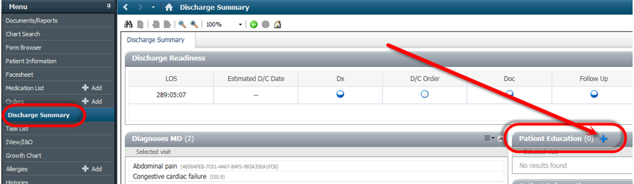
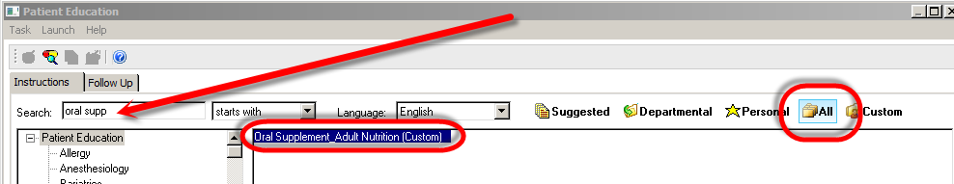
Develop Discharge Plan
Actions
1. Dietitian selects Discharge Summary and Patient Education
2. Add Oral Supplement, Adult to document

Slide 29
Discharge Process
Dietitian documents discharge supplement recommendations and instructions in the medical record, to be included in the printed discharge instructions
Physician completes discharge criteria, including instructions for continuation of oral supplement
Physician completes discharge criteria, including instructions for continuation of oral supplement
Notes:
When the patient is admitted the discharge document is initiated so is there the entire stay and other disciplines can document on it

Slide 30
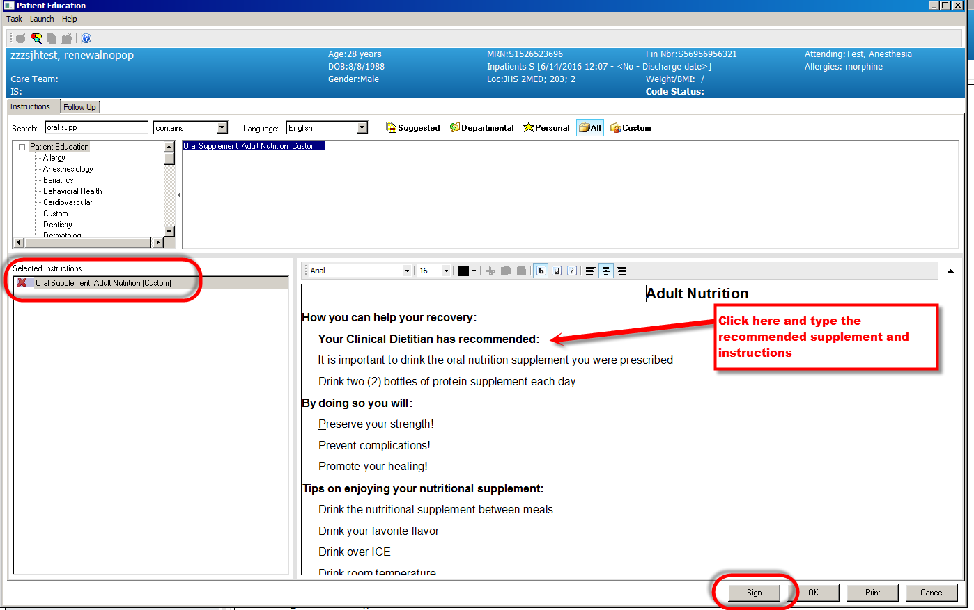
Develop Discharge Plan
Actions:
Dietitian adds oral supplement recommendation and signs

Slide 31
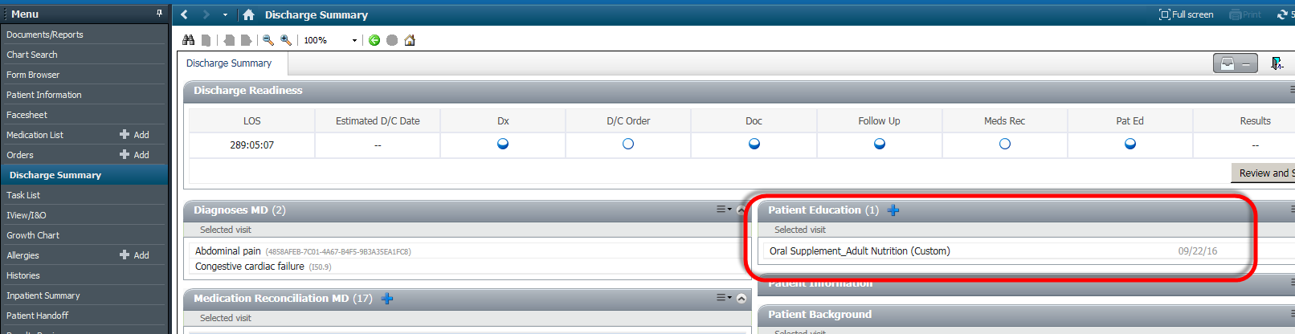
Develop Discharge Plan
Actions:
Oral Supplement, Adult Nutrition displays in the Patient Education component within the Discharge Summary/Depart process

Slide 32
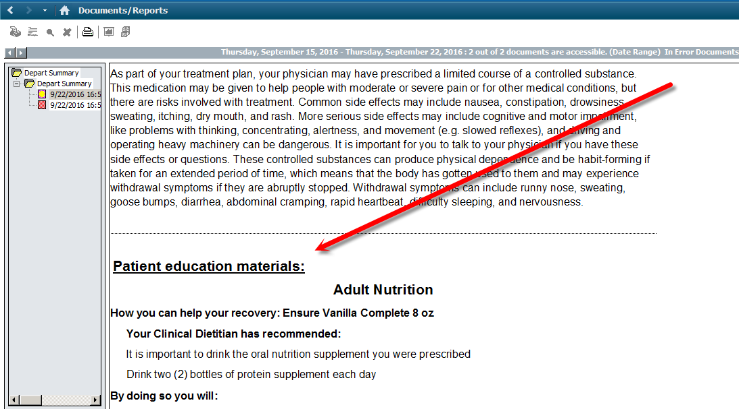
Develop Discharge Plan
Actions:
Leaflet auto displays in the Patient Education Materials section in printed discharge instructions

Slide 33
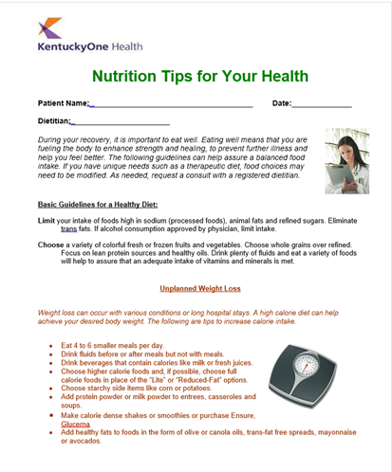
Develop Discharge Plan
Nurse and Dietitian provide patient education via Discharge Instruction information
Handouts included in Discharge folder paperwork and used to reinforce importance of ONS post-discharge
Dietitian provides ONS coupons and samples
Notes:
Storage bins containing samples, coupons, and extra printed educational handouts are placed on all appropriate units

Slide 34
Compliance
EHR report available to assist with auditing compliance of MST >2 patients and ordering ONS includes:
  Admitted patients during the Date Range entered with a MST Score of two or greater
  MST score and MST score date & time documented
  Oral supplement order with date & time ordered (contains the type of supplement selected and typed special instructions)
  Diet Order with date & time ordered
  Malnutrition Diagnosis—any active diagnosis entered by the physician that surrounds Malnutrition (per codified values)—may be an admitting diagnosis, discharge diagnosis, working diagnosis, etc.

Slide 35
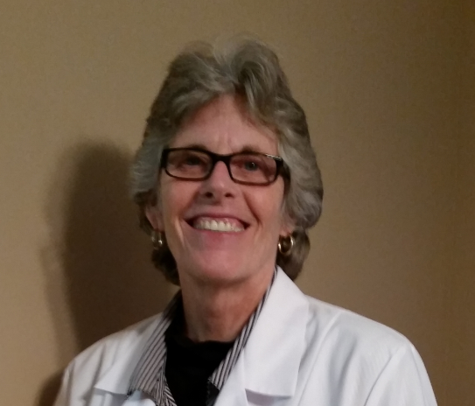
Susan Fuchs, MBA, RD, LDN
Clinical Nutrition Manager
CHI Memorial Hospital & CHI Memorial Hixson
35
Notes:
Susan Fuchs is a Clinical Nutrition Manager with Sodexo. She leads the clinical nutrition team at CHI Memorial, a division of Catholic Health Initiatives. She earned a Bachelor’s Degree in Nutrition and Dietetics from the University of Florida, and her Master of Business Administration from University of Tennessee Chattanooga. Susan has over 38 years of experience working in healthcare. She has been an adjunct instructor teaching Nutrition at Chattanooga State Community College for the past 18 years.

Slide 36
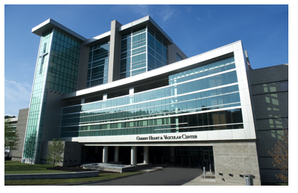
CHI Memorial Health
Who We Are:
Located in:
  Chattanooga & Hixson, Tennessee and North Georgia
Owned by:
  Catholic Health Initiatives
Recent Recognition:
  NRC Top Consumer Loyalty Award ranked CHI Memorial #1 in the US August 2018
  Based on CHI Living Our Mission Measures, CHI Memorial is currently #1 in the Southeast Division for Patient Experience: Overall Rating of Hospital
CHI Memorial is a regional referral center of choice with more than 3500 associates and more than 650 affiliated physicians providing healthcare throughout Southeast Tennessee and North Georgia

Slide 37
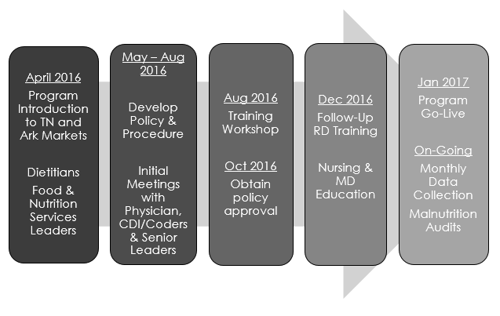
Malnutrition Program Implementation:
Key Milestones

Slide 38
CHI Memorial Hospital

Slide 39
CHI Memorial Hixson

Slide 40
Challenges
  Importance of accurate entry of patient data in the Malnutrition Screening Tool (MST) at time of admission
  Referrals entered by Nursing when MST score is 2 or greater
    RD nutrition assessment/intervention begins with this referral
    Monthly monitoring of MST accuracy and entry is reported at Clinical Operations Council (Nursing Leadership Meeting)
  MD reviewing and signing the form left in the chart
    When MD notes type of malnutrition (already identified by the RD on the form) and signs in designated area, this converts the nutritional diagnosis of malnutrition by the RD to a medical diagnosis of malnutrition by the MD
    Results were reported to Medical Director of Case Management; He discussed the importance of signing the form with the hospitalists in their April 2018 meeting; A follow up in-service with hospitalists is currently scheduled for November 2018.

Slide 41
Benefits
  Improved clinical outcomes for our patients
  Decreased readmission rates on the Glenwood campus
  Increased patient education at discharge
  Increased reimbursement from Malnutrition Coding
  FY18 3rd Quarter Results:
    Glenwood $155,026.57
    Hixson $32,891.09
    Total: $187,917.66

Slide 42

Studying our Work
This Photo by Unknown Author is licensed under CC BY

Slide 43
CHI Malnutrition Research: A Look at SJH, SJE & Jewish Hospital
Partnered with Sodexo and Abbott
The Impact of a Nutrition-Focused Quality Improvement Intervention on Length of Stay Among Hospitalized Malnourished Patients
Poster Session Presented at the Academy Health Conference – June 25, 2018
Objectives: Nutrition-focused quality improvement (QI) initiatives were implemented to determine if early malnutrition risk identification and initiation of nutrition therapy impacted length of stay, readmission rates, and diagnosis of malnutrition.
Results:
The median time from patient hospital arrival, admission and MST to ONS initiation was reduced by 29.1%, 14.9% and 39.3% respectively (all p <0.01).
Decreases in LOS and readmission rates were 0.88 days (p<0.05) and 0.15% (p>0.1) greater for the treatment group compared to the control group.
Patients diagnosed with malnutrition increased from 3.14% to 6.84% (p<0.01) after the QIP

Slide 44
Tools & Resources
KentuckyOne Health
  3-step process *
  EMR screen shots for IT *
  Malnutrition Policy *
Advocate roadmap published in PDF*
Data and supporting evidence*

Slide 45
Requirements to Receive HealthTrust QTR Rebate
Through the Term of the Nutritional 220 Contract 2022
Malnutrition Protocol based on validated tools and proven nutrition practices that begins at admission and continues post-discharge.
Required Components:
Validated malnutrition screening tool (MST)
Automatic provision of rapid nutrition intervention (24 hrs.) and RD referral initiated by MST risk level
Discharge procedures include documented instructions and written patient education for the continuation of nutrition interventions used during hospitalization
**Protocols must be part of written, approved policy and embedded in EMR.

Slide 46
Thank You!
Thank you for joining our session today.
Speaker Contact Information:
Amanda Goldman, MS, RD, LD, FAND
AmandaGoldman@catholichealth.net
Sharon Siegel, RD, LD
SharonSiegel2@KentuckyOneHealth.org
Susan Fuchs, MBA, RD, LDN
Susan_Fuchs@memorial.org

