Slide 1
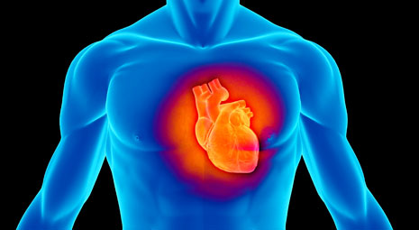
Capnography: It’s about more than ventilation!
HealthTrust Resuscitation Webinar Series

Slide 2
Nicole Kupchik MN, RN, CCNS, CCRN, PCCN-CMC
Clinical Nurse Specialist
Former Code Blue Committee Co-Chair
Currently consultant
Staff Nurse
National resuscitation presentations:
American Heart Association (AHA)
Emergency Cardiovascular Care Updates (ECCU)
Society of Critical Care Medicine (SCCM)
National Teaching Institute (NTI)
Emergency Nurses Association (ENA)

Slide 3
Capnography: It’s about more than ventilation!
HealthTrust Resuscitation Webinar Series

Slide 4
4-Part Resuscitation Webinar Series
September 28th – What’s New with the ACLS & BLS Guidelines?
December 20th – High Quality CPR & Why It Matters!
February 1st – Capnography: It’s about more than ventilation!
March 1st – My Patient was Resuscitated, Now What?

Slide 5
Objectives:
Discuss normal & abnormal V/Q relationships
Describe Capnography as an indicator of fluid responsiveness
Discuss the integration of Capnography into a resuscitation program

Slide 6
Carbon dioxide
There’s what you exhale
Normal: 35 – 45 mm Hg
(V = ventilation)
There’s what you measure in the arterial blood
Normal: 35 – 45 mm Hg
(Q = Perfusion)
The relationship between them is V/Q

Slide 7
Capnography Assesses Physiological Functions
Provides real-time assessment of respiratory, circulatory & metabolic status
VENTILATION
Tells us how effectively the patient is exhaling CO₂
PERFUSION
Tells us how effectively the body is transporting CO₂
METABOLISM
Tells us how effectively the body is producing CO₂

Slide 8
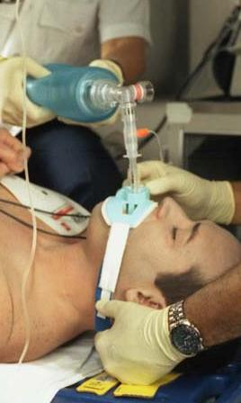
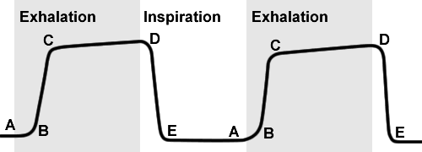
When to use Waveform Capnography?
Gold standard for endotracheal tube placement
Moderate to deep sedation
High risk patient on PCA
Transporting intubated patients
Identifying septic patients
Fluid responsiveness & resuscitation
Cardiac arrest
Quality indicator of compressions
Information helpful to determine cessation of resuscitation efforts
Post arrest

Slide 9
Capnography terms defined:
Capnometry
Numerical value of the EtCO₂
A Capnometer provides only a numerical measurement of CO₂
Capnogram
Waveform tracing of EtCO₂ over time
A Capnograph provides a waveform called “capnogram”
Capnography
Ventilation rate, quality & waveform
Capnography provides EtCO₂, ventilation rate & capnogram
Notes:
As we begin this module, it is important to understand the difference between some key terms.
The first term “Capnometry” is the numerical value of the concentration of CO2 in exhaled breath.
This numerical measurement is obtained by a device called a Capnometer.
The second term is "capnogram“.
Capnogram refers to the graphical representation of the concentration of inhaled and exhaled CO2.
This type of graph is referred to as a waveform. A capnogram is obtained by a capnograph.
Both the numerical measurement and capnogram are necessary in order to
provide a complete picture of the patient's ventilation for clinical evaluation.
Capnography is the non-invasive, continuous measurement of carbon dioxide concentration, commonly referred to as end-tidal carbon dioxide or etCO2.

Slide 10
PetCO₂ & SpO₂ are both important, but different measurements!
Pulse oximetry
Hypoventilation & apnea detected immediately
Values lag with hypoventilation & apnea
Capnography
Reflects oxygenation
Reflects ventilation
“Cases of respiratory depression were 28 times as likely to be detected if they were monitored by capnography, as those who were not monitored.”
“…end tidal carbon dioxide monitoring is an important addition to oximetry for detecting respiratory depression”
Waugh et al (2007). Respiratory Care; 52(11)
Notes:
Let's compare Pulse oximetry & etCO_{2 and what each meausrement} provides s
Capnography monitors “ventilation”; providing the etCO₂ which as you remember reflects the effectiveness of breathing,
Capnography provides the earliest indication of hypoventilation, airway obstruction and episodes of apnea or a lack of breathing. And, the capnography alarm alerts you for early intervention, before clinical assessment, and more effectively than pulse oximetry.
Pulse oximetry monitors “oxygenation”; providing the SpO₂ which reflects the percentage of the red blood cells that are saturated with oxygen. It does not tell you the rate your patient is breathing, and can be a late indicator with hypoventilation, airway obstruction and apnea. In addition; the use of supplemental oxygen can further delay the detection of airway compromise when monitoring with pulse oximetry.
This is supported by a recent meta-analysis of eight prospective clinical studies which concluded that cases of respiratory depression were 28 times as likely to be detected, if they were monitored by capnography, as those who were not monitored.
In addition, the authors note that end tidal carbon dioxide monitoring is an important addition to oximetry for detecting respiratory depression; but that data in the literature does not support substituting oximetry for capnography when monitoring for respiratory depression; and that some investigators have concluded it would be dangerous to do so.
Just as etCO₂ monitoring does not measure oxygenation, pulse oximetry does not measure ventilation.
Listed below are studies that support the statements on this slide:
2008 American Society of Anesthesiologists, Practice Guidelines for the Prevention, Detection, and Management of Respiratory Depression Associated with Neuraxial Opioid Administration,
Monitoring to Improve Ventilation Safety During Sedation and Analgesia. Waugh JB, Khodneva Y, Epps CA, Anesthesia and Analgesia, 2008
Comparison of Apnea Detection by Pulse Oximetry versus Capnography. Waugh JB, et al. Respiratory Care, 2007

Slide 11
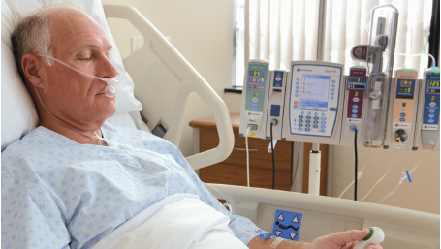
PCA pumps now have Capnography!

Slide 12
American Society of Anesthesiologists
National standard mandate
Ventilation should be monitored via PEtCO₂ for all patients receiving moderate to deep sedation who are not intubated
Since 2010!

Slide 13
Sedation & analgesia
Medications can affect ventilatory status
Analgesia
Fentanyl
Morphine
Meperidine
Sedation
Diazepam
Lorazepam
Midazolam
EtCO₂ trends
Determine degree of hypoventilation
Early indicator of respiratory failure
Notes:
Any patient that receives analgesia or sedation for pain control or anxiety may have a change in mental status that is accompanied by hypoventilation. Some common medications are listed on this slide. Patients receiving these medications can be effectively monitored with capnography to determine the precise impact of the medications, on their ventilatory status. EtCO₂ trends can determine the degree of hypoventilation and indicate impending respiratory failure. This is particularly important in those patients who have a change in mental status and are not able to reliably provide feedback on their condition.

Slide 14
Alcohol Intoxication or Drug Ingestion
Excessive alcohol alone or combined with sedative drugs can cause
Severe hypoventilation
Obtundation
Respiratory failure
Capnography provides an early indicator
of impending respiratory failure.
Notes:
Alcohol is a central nervous system depressant, and when taken in excess, alone or in combination with sedative drugs, can cause severe hypoventilation, obtundation, progressing to respiratory failure. When a patient is obtunded or unconscious due to alcohol or drug ingestion, capnography is essential as it is the only direct, non-invasive window to evaluate the patient’s ventilatory status. Capnography will monitor the patient’s breathing and provide the earliest indicator of impending respiratory failure.

Slide 15
Capnography Use Emergencies: The Non-intubated Patient
Metabolic Emergencies
Cardiovascular Emergencies
Diabetic emergencies/DKA
Sympathomimetic overdose
Seizures
Sepsis
Hyper/Hypothermia
Gastroenteritis
CHF
Acute Myocardial Infarction
Blood loss/Shock
Pulmonary embolism

Slide 16
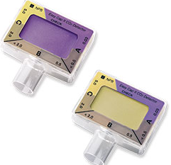
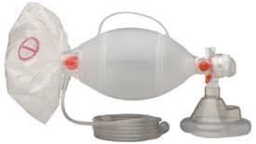
Capnography
Can use with:
Endotracheal tube
Trach
BVM
Nasal cannula
Notes:
Here are examples of the newer low-flow sidestream cannulas and tubing. The nasal/oral cannula also delivers oxygen. The ET tube connector with the orange colored filter is easily seen here.
Teaching Note: Samples of the cannulas are useful to show.

Slide 17
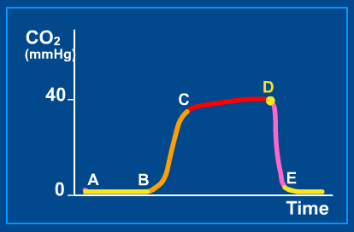
About the normal PEtCO₂ waveform…
B - C: Rapid rise in CO₂, early exhalation – clearing dead space
C - D: Alveolar Plateau: Alveolar gas exchange
D: End of Exhalation: point where EtCO₂ is measured
D - E: Inspiration, rapid decrease of CO₂
A - B: Baseline, no CO₂ being exhaled
Notes:
Now that we understand how to evaluate the waveform, let’s learn what is happening during each segment.
A to B shows the waveform baseline. This is the start of exhalation and there should be little or no CO2
B to C shows early exhalation where the rise in CO2 from the exhaled air in the upper airways mixes with alveolar gas.
At C to D the waveform levels off representing the concentration of CO2 in the alveolar gas.
D is the point at the end of expiration or “end tidal”, and just before inspiration. This is where the etCO2 is measured.
The end of the waveform is segment D to E, a rapid, sharp down stroke indicating a drop in CO2 back to zero, and the beginning of inspiration.
Important things to remember about the waveform:
Waveform will not be normal when patient is talking, and
The absence of a waveform or “flat-line” is the earliest indication of airway obstruction or “no breath”.
Now let’s review some abnormal waveforms.

Slide 18
Waveforms in different clinical situations – Increase in PEtCO₂
Hypermetabolic state
NaHCO₃ administration
Partial airway obstruction
Sudden hypoventilation
Sudden increase in temperature or BP

Slide 19
Waveforms in different clinical situations – Loss of plateau
Bronchospasm (asthma)
COPD
Cuff leak
Kinked ET tube
Partial airway obstruction

Slide 20
Waveforms in different clinical situations – Downward plateau slope
Severe emphysema

Slide 21
Waveforms in different clinical situations – Increase in baseline
Rebreathing CO₂
Exhausted with hypoventilation
Need for calibration
Contaminated sensor

Slide 22
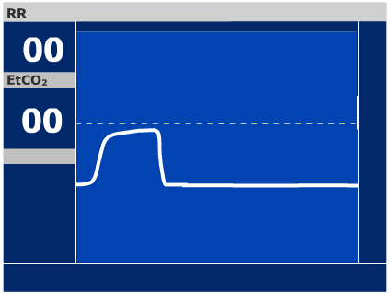
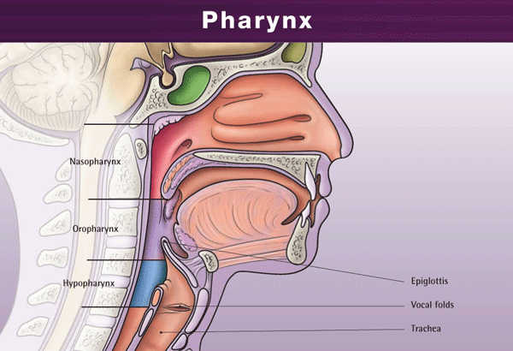
ET Tube dislodgement
Detects ET tube dislodgement by an immediate change in the waveform
Esophageal dislodgement produces a “flat line”
Hypopharynx will show low, irregular levels of CO₂
Hypopharynx
Notes:
Once you have verified that initial endotracheal tube placement is correct, continuous monitoring of endotracheal tube position during transport is essential. Capnography will immediately help you recognize dislodged endotracheal tubes.
Studies in the emergency medicine literature report a 5 to 25 percent rate of unrecognized misplaced or dislodged endotracheal tubes upon arrival at the receiving facility. Capnography can be used to initially verify endotracheal tube placement and continuously monitors tube position. If dislodgement occurs, there will be an immediate change in the waveform and value.

Slide 23
Quick stats lesson!
CVP is a HUGE FAIL!!!
(plus useless & stupid!!!!)
So why are we still measuring it?!
The ability of each parameter
to predict fluid responsiveness:
Area under the curve (AUC):
1.0 = Perfect!
0.99 – 0.9 = Excellent!
0.8 – 0.9 = Good!
0.7 – 0.8 = Fair
0.6 – 0.7 = Poor
0.5 – 0.6 = Fail
AUC CVP = 0.56
Michard et. al Am J Resp Crit Care Med, 2000
Notes:
.90-1 = excellent (A)
.80-.90 = good (B)
.70-.80 = fair (C)
.60-.70 = poor (D)
.50-.60 = fail (F)
23

Slide 24
Does Capnography predict sepsis?
≥ 2 SIRS Criteria
EtCO₂ < 25 mmHg
Suspicion of infection
Sepsis Alert activation
AUC 0.99!!!! WOW!!!!
Hunter EL et al (2016) Am J Emerg Med

Slide 25
CO₂ regulation
As respiration rate & depth increase,
As respiration rate & depth decrease,
CO₂ is retained
CO₂ is exhaled
Blood
CO₂
increases
Blood
CO₂
decreases
Notes:
The frequency of respiratory cycle is referred to as the “respiration rate” and the volume or amplitude of each respiratory movement is referred to as the “respiration depth”. During normal breathing, respiration rate and depth are adjusted to regulate CO2 levels in the blood.
With normal healthy lungs, as the respiration rate and/or depth increases, more carbon dioxide is removed; conversely as the respiration rate and/or depth decreases less carbon dioxide is removed. This concept is important because during extreme hypoventilation states; meaning very low respiration rates and/or decreased respiration depth; there is insufficient CO2 removed to prevent toxic build-up in the blood.
Capnography monitors CO2 removal during breathing and provides a waveform of every breath; it provides the earliest indication of hypoventilation, airway obstruction and episodes of no breath. The capnography alarm will alert you for early intervention, before clinical assessment, and more effectively than pulse oximetry.
Lets learn more about how capnography and pulse oximetry differ.
Listed below are studies that support the statements on this slide:
Scanlan CL, Wilkins RL, Stoller JK. Egan’s Fundamentals of Respiratory Care, 8th Ed. St. Louis: Mosby; 2003.
Comparison of Apnea Detection by Pulse Oximetry versus Capnography. Waugh JB, et al. Respiratory Care, 2007
Does end tidal CO2 monitoring during emergency department procedural sedation and analgesia with propofol decrease the incidence of hypoxic events? A randomized, controlled trial. Deitch K, Miner J, et al. Annals of Emergency Medicine. September 2009

Slide 26
Measuring respiratory rates…
Manual Counting
Measures:
Chest movement
Based on observation or auscultation, may be restricted by patient movement, draping or technique
Impedance
Measures:
Chest movement with ECG leads
Based on measuring respiratory effort or any other sufficient movement of the chest
PEtCO₂
Measures:
Respiratory gas movement at the mouth or nose
Hypoventilation & absence of breath detected immediately!
Most accurate RR
Notes:
Obtaining an accurate respiratory rate is important, and different techniques can result in different respiration rates
A manual respiratory count reflects a single moment in time where you observe and count the patient’s chest rise and fall and or listen to breath sounds. This method requires your presence in the room. In addition, blankets or patient position can limit the visualization of chest movement. Also, with complete airway obstruction there may continue to be chest movement as the patient attempts to breathe. Lastly, there is no automated documentation or alarm if your patient fails to breathe when you are not in the room.
Impedance Pneumography, or measuring RR with ECG leads; provides a respiratory rate based on respiratory effort ...the attempt to breathe or any other sufficient movement of the chest.
Capnography measures respirations at the airway through respiratory gas movement at the mouth or nose. A respiration is counted when there is a qualifying amount of carbon dioxide exhaled, and it does this even when the clinician is not in the room!

Slide 27
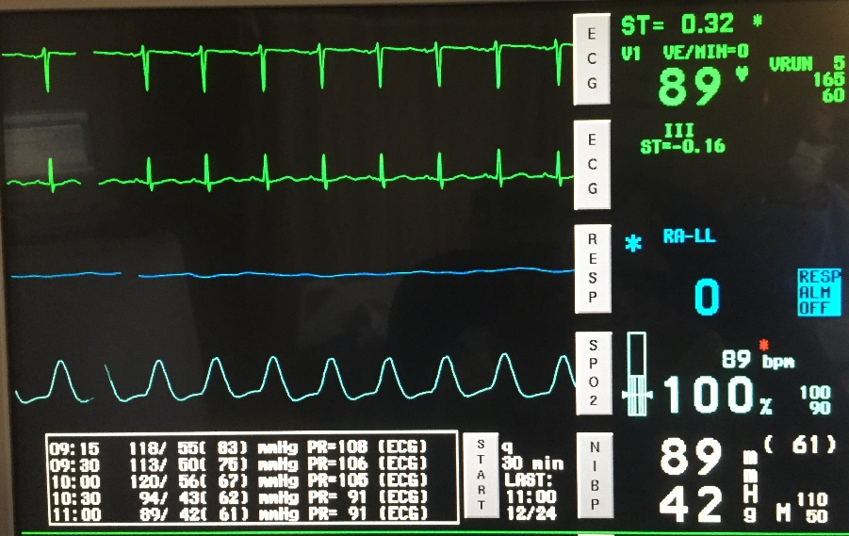
Case #1
63 year old patient with sepsis
Intubated & now hypotensive:
HR 89, BP 89/42 (61), vented rate 20, breathing 21, O₂ sat 100%
Has a central line in place
CVP 10 mm Hg
Treatment: Fluids, pressors or inotropes?

Slide 28
Passive leg raise test (PLR)
Transfer of blood from legs & abdominal compartment toward the heart
Legs elevated for 1 - 2 minutes
Re-evaluate – requires stroke volume measure

Slide 29
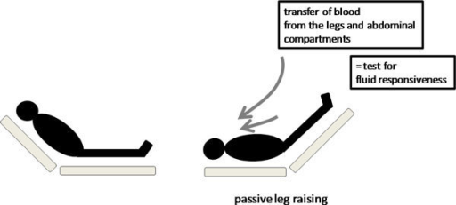
EtCO₂ predicts fluid responsiveness with PLR
65 ventilated patients needing volume expansion
Compared changes in EtCO₂ with arterial pressure to reflect changes in CO/CI
EtCO₂ increase ≥ 5% predicted fluid responsiveness (p=0.0001)
Increase reflected CI ≥ 15%
The changes in EtCO₂ induced by a PLR test predicted fluid responsiveness with reliability, while the changes in arterial pulse pressure did not.
Monnet et al (2013) Intensive Care Medicine
Notes:
CO evaluated with PICCO device

Slide 30
PEtCO₂ & fluid responsiveness
≥ 5% increase EtCO₂
500 cc fluid bolus over 30 min
Monnet et al (2013) Intensive Care Medicine

Slide 31
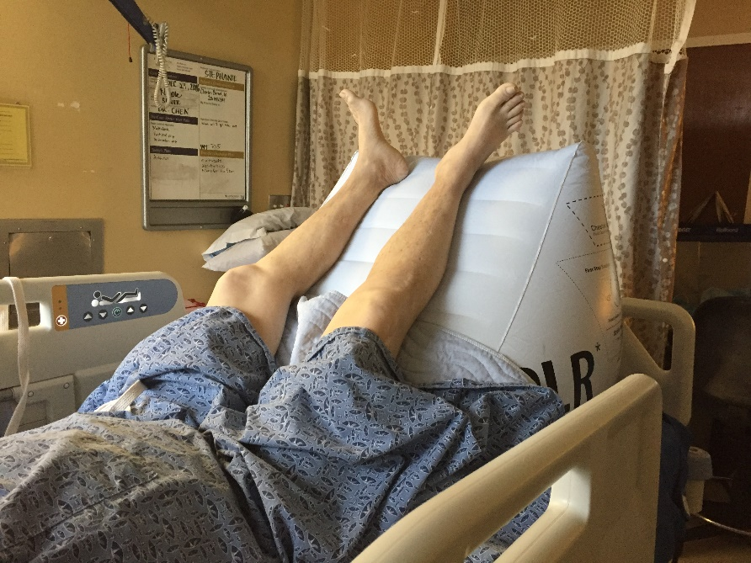
Passive Leg Raising (PLR)
Patient – HOB 45˚
Obtain Capnography reading
Baseline Capno: 29 mm Hg

Slide 32
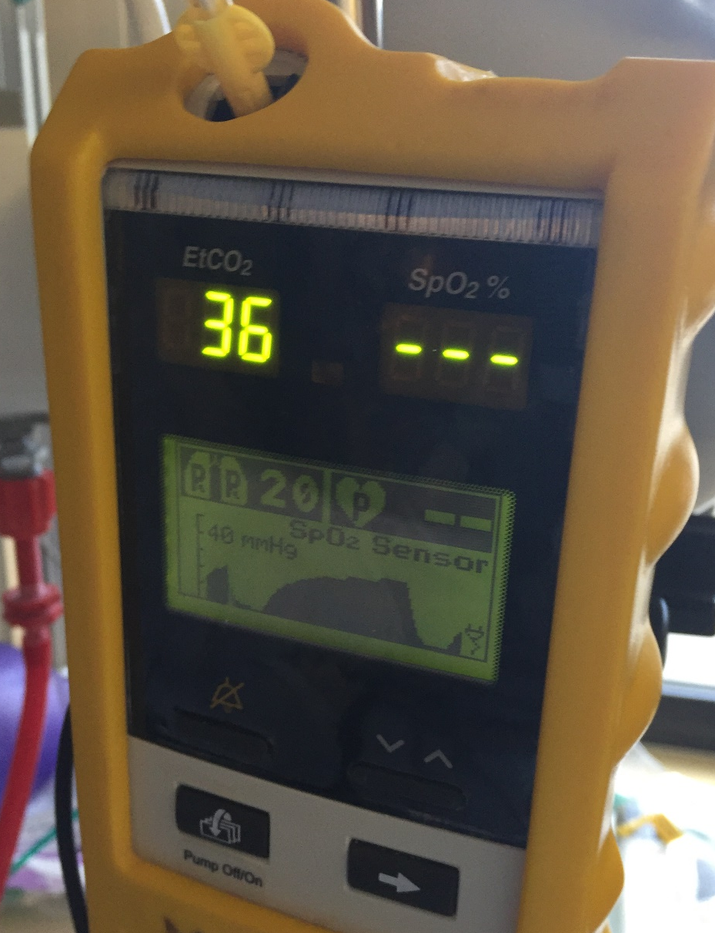
Post PLR
Lift legs for 1 – 2 minutes
Capno reads 36 mm Hg after 90 sec
What does the patient need?
Fluids!!!!!

Slide 33
PLR & Prediction of Fluid Responsiveness
Cardiac Index
EtCO₂
Arterial pressure AUC 0.65
EtCO₂ AUC 0.93
Cardiac Index AUC 0.98
Arterial
pressure
Coin flip!
(CVP)
Monnet et al (2013) Intensive Care Medicine

Slide 34
Contraindications to the passive leg raise test (PLR):
Intra-abdominal hypertension
Head trauma/ICP issues
LE DVT
Venous compression stockings
Amputated leg

Slide 35
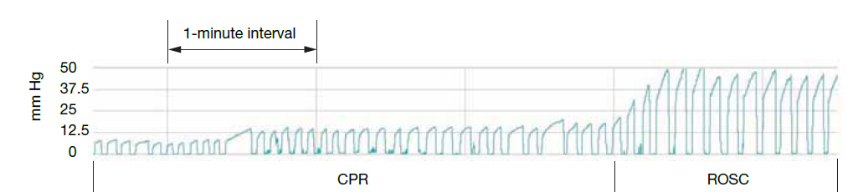
Waveform Capnography
Gold standard for confirming endotracheal tube placement
Used as a marker of perfusion
Normal is 35 – 45 mm Hg
Goal with compressions is at least 10 mm Hg
Will see increase with ROSC

Slide 36
2015 Capnography & Ventilation Levels of Evidence – ILCOR/AHA
Recommendation | Class | LOE
Continuous Waveform Capnography to verify ETT placement | I | C-LD
Capnography as a measure of CPR quality
Capnography as an indicator of ROSC
Low PEtCO₂ (< 10 mmHg) after 20 minutes in intubated patients is strongly associated with failure of resuscitation | IIb | C-LD
Should not be used in isolation or in non-intubated patients as a marker to terminate resuscitation | III
Ventilation rate 10 breaths per minute with an advanced airway | IIb | C-LD
Neumar et al (2015). Circulation;132[suppl 2]:S315-S367

Slide 38
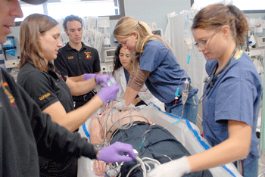
Capnography Case #2
54-years old, collapsed Jan 5, 2011 outside Don’s Foods in Goodhue, MN (pop. 900)
2 dozen rescuers took turns providing CPR for 96 minutes
6 shocks with first responder AED, 6 more shocks by Mayo Clinic Air Flight Medics
Transported to Mayo Clinic Cardiac Cath Lab

Slide 39
Ventricular fibrillation continues…
Ongoing CPR with transport
Defibrillation every 2 min
Epinephrine every 3 – 5 min
Amiodorone 300 mg
PetCO₂ reads 32 – 37 mmHg
What should you do?
Keep going!!! Get the patient to the cath lab!!!

Slide 40
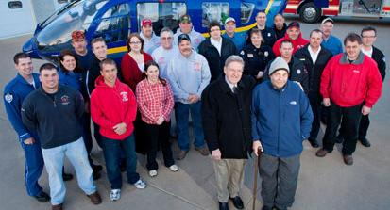
Why Not Quit?
Thrombectomy, stent to LAD
10 days in hospital
“The capnography told us not to give up!”
EtCO₂ averaged 35 mmHg (range 32 – 37)

Slide 41
PEtCO₂ as a predictor of ROSC
90 pre-hospital patients intubated in the field
16 survivors
In 13 survivors, a rapid rise in measured exhaled CO₂ was the earliest indicator of ROSC
Before a pulse or blood pressure were palpable
Wayne MA, Levine RL, Miller CC. “Use of End-tidal Carbon Dioxide to Predict Outcome in Prehospital Cardiac Arrest”. Annals of Emergency Medicine. 1995; 25(6):762-767.
Notes:
Using an EtCO₂ of 10 mmHg or less as a theoretical threshold to predict death in the field successfully discriminated between the 16 survivors to hospital admission (those that achieved return of spontaneous circulation) and 75 prehospital deaths. Of the 16 survivors to hospital admission, 9 died in the hospital, and 7 were discharged from the hospital alive. In 13 of the 16 survivors, the first evidence of return of spontaneous circulation, before a palpable pulse or blood pressure, was a rising ETCO₂.

Slide 42
Capnography Case #3
58 y/o male admitted to the ortho unit post laminectomy
8 hours post-op he suffered 70 min Vfib arrest
EtCO₂ remained in the 30 - 40s during the code
The next day he was awake and alert but remained intubated
Discharged to home on day 7 fully intact

Slide 43
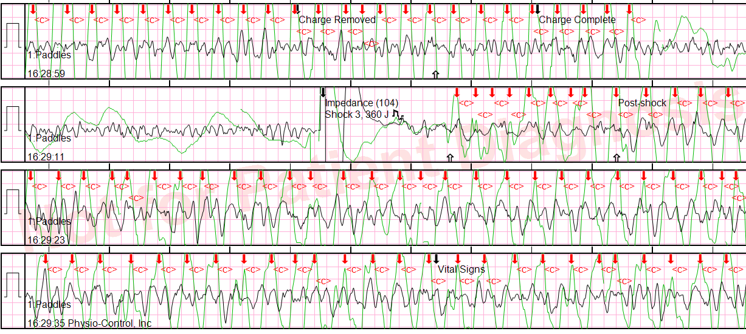
Vfib arrest, shocked 8 times
Short pre & post shock pauses!!!!
CCF was 81%
CC rates were a bit fast, 120s – 130s

Slide 44
Capnography Case #4
38 year old patient has been in PEA Arrest for over 20 min
Suspicion of hypoxia from a drug overdose
Ongoing chest compressions
Intubated without incident
Capnography (PEtCO₂) reading 24 mmHg with CC
ABG obtained with the following results:
pH: 7.18
PaCO₂: 82
PaO₂: 106
HCO₃: 26
Base Excess: -6
O₂ sat: 91%
Lactate 4.8
You are instructed to ventilate the patient faster to “blow off” the CO₂.
What should you do?

Slide 45
Case #5 52 year old patient goes into Ventricular Fibrillation
Chest compressions started
Defibrillated with 200 joules, chest compressions immediately restarted
Epinephrine 1 mg administered
Intubated with assisted ventilations with 1 breath every 6 seconds
Waveform Capnography started initial reading is 20 mmHg
Recommendations?

Slide 46
After 4 minutes…
Rhythm is assessed, remains in Ventricular Fibrillation
Defibrillated with 300 joules, new provider begins compressions
Waveform Capnography reading 9 mm Hg
Recommendation?
Compress deeper, assess rate!
Provider compresses deeper, but PEtCO₂ remains < 10 mm Hg
Recommendations?
New provider!

Slide 47
3 minutes later (7 min into the arrest)
Waveform Capnography is reading 38 mmHg
Recommendations?
Go until the end of the 2 minute cycle & assess for a pulse
At the end of 2 minutes, there is a pulse!!!
Waveform Capnography is currently reading 34 mmHg

Slide 48
Post-Resuscitation started
Patient is mechanically ventilated
Capnography has trended from 34 mmHg to 26 mmHg
BP 80/56, HR 92 bpm, O₂ sat 94%
What do you think about this?
The patient’s cardiac output is dropping…assess need for fluid, positive inotrope, vasopressor

Slide 49
Post-Arrest Capnography
1.5 liters of fluid administered
Capnography went from 26 mm Hg to 32 mm Hg
Recommendations?
Consider more fluid, assess LV function

Slide 50
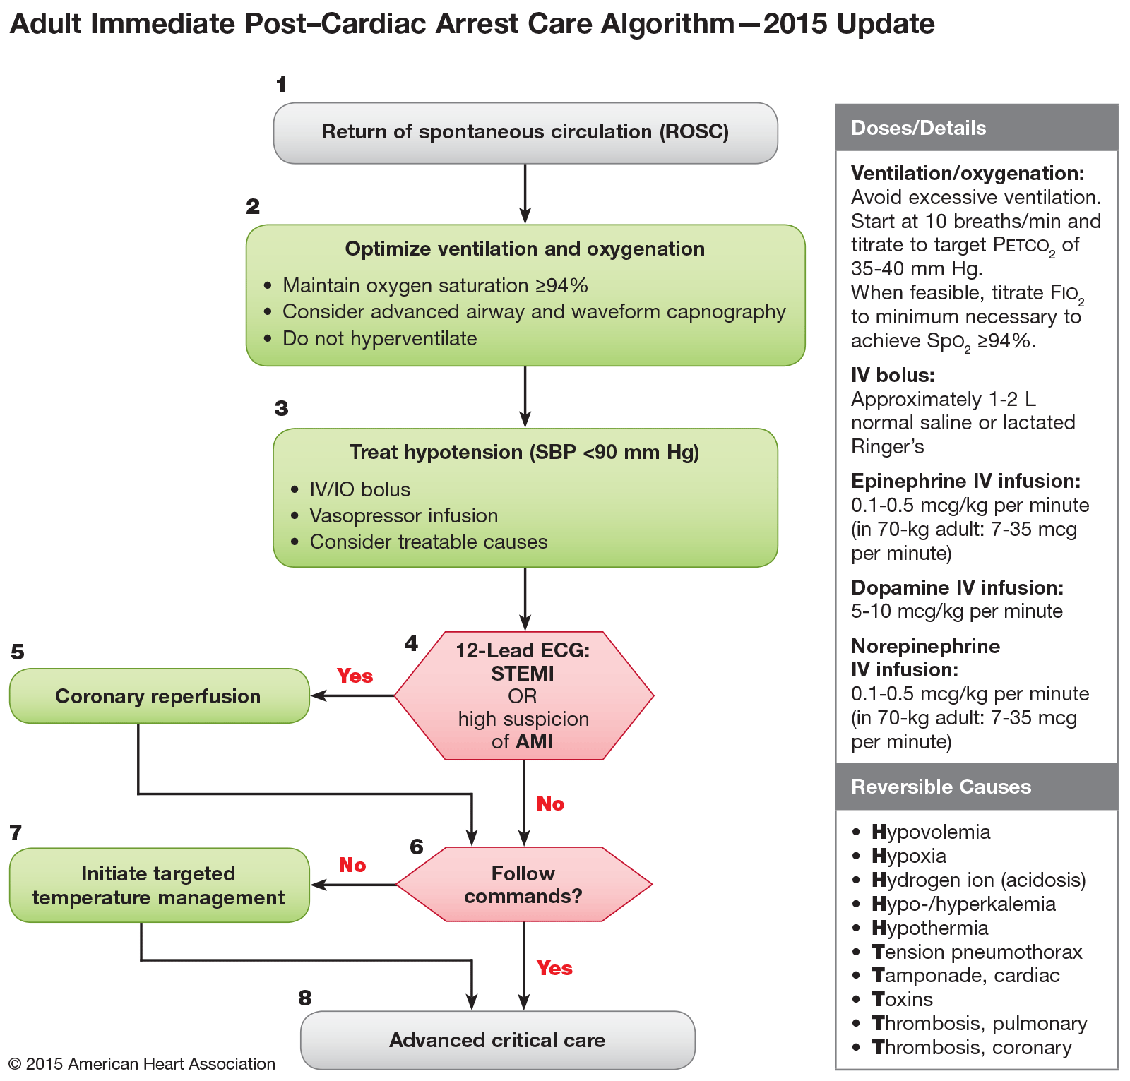
Post-Arrest Capnography
It can be especially helpful to monitor PEtCO₂ post arrest!
Downward trends could signify low perfusion &
re-arrest

Slide 51
Case #5 Exceptions…
49 year old female present to the ED with SOB
Being treated for a LLE DVT she developed after surgery
C/O shortness of breath with increasing O₂ needs and “impending feeling of doom”
Goes into PEA Arrest
Chest compressions started
Your differential?
Pulmonary embolism

Slide 52
Case #5 continued
rTPA ordered & given
Intubated without interrupting chest compressions
EtCO₂ read 8 mmHg
CPR quality is incredible!!!
Why is it only reading 8 mmHg?
She has a VQ mismatch
What will happen to serum levels of CO₂?
Pulmonary embolism

Slide 53
V/Q Mismatch
Pulmonary embolism = lots of dead space
Dead space = volume of air inhaled that does not take part in gas exchange
V = air reaches alveoli, Q = blood reaches alveoli
If the dead space is < 30%, it is considered normal
< 30%, not a PE, 100% negative predictive value
Dead space calculation:
(PaCO₂ – PEtCO₂) ÷ PaCO₂

Slide 54
Calculation: (PaCO₂ – PEtCO₂) ÷ PaCO₂
Example #1:
ABG: pH 7.32, PaCO₂ 49, PaO₂ 145, HCO₃ 22
EtCO₂ = 44 mm Hg
(49 – 44) = 5 ÷ 49 = 0.10 or 10%
Example #2:
ABG: pH 7.24, PaCO₂ 64, PaO₂ 65, HCO₃ 19
EtCO₂ = 24 mm Hg
(64 – 24) = 40 ÷ 64 = 0.625 or 62.5%

Slide 55
Case continued (PaCO₂ – PetCO₂) ÷ PaCO₂
EtCO₂ up to 11 mmHg and we achieved ROSC
rtPA completed
2 hours later EtCO₂ was 15 mmHg, PaCO₂ 56, on FiO₂ 100%
Dead space = 73%
6 hours later EtCO₂ was 24 mmHg, PaCO₂ 48, on FiO₂ 80%
Dead space = 50%
12 hours later EtCO₂ 30 mmHg, PaCO₂ 40, on FiO₂ 70%
Dead space = 25%
Prognosis?
Good! The rtPA lysed the blood clot
This is evidenced by the improvement in the V/Q mismatch!

Slide 56
In conclusion:
Capnography is a Level 1A recommendation for verification of endotracheal tube placement
Capnography can be helpful with:
Monitoring ventilation in intubated & non-intubated patients
Identifying sepsis
Fluid responsiveness
V/Q matching
CPR quality & termination of resuscitation efforts

